Slide 1
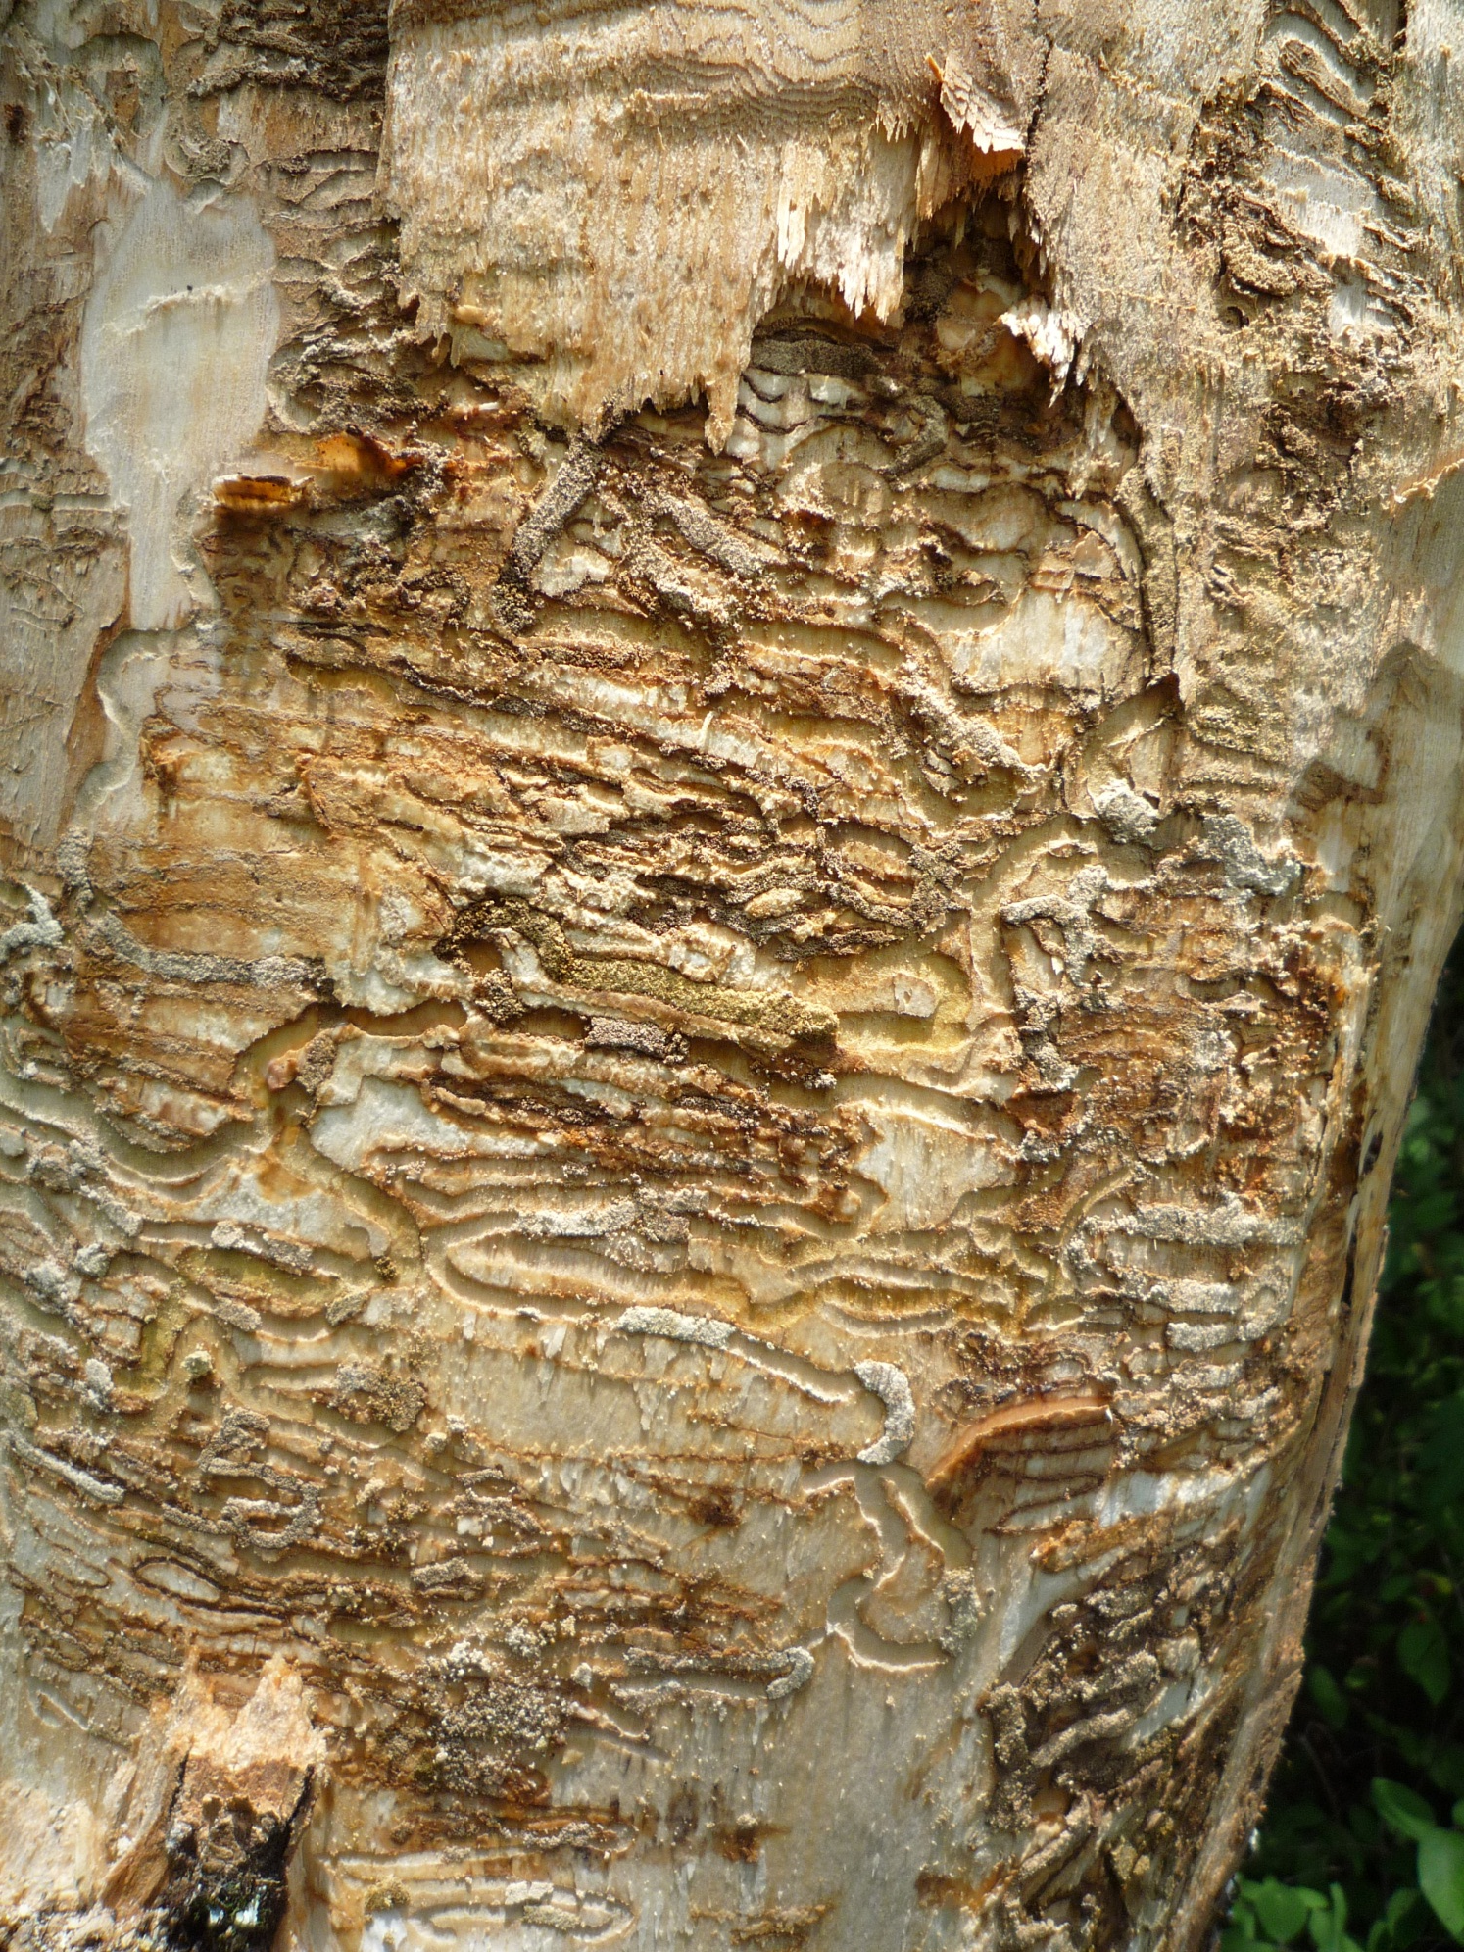
How are we going to deal with
The Emerald Ash Borer?
Mark Whitmore
Dept. of Natural Resources
Cornell University
mcw42@cornell.edu

Slide 2
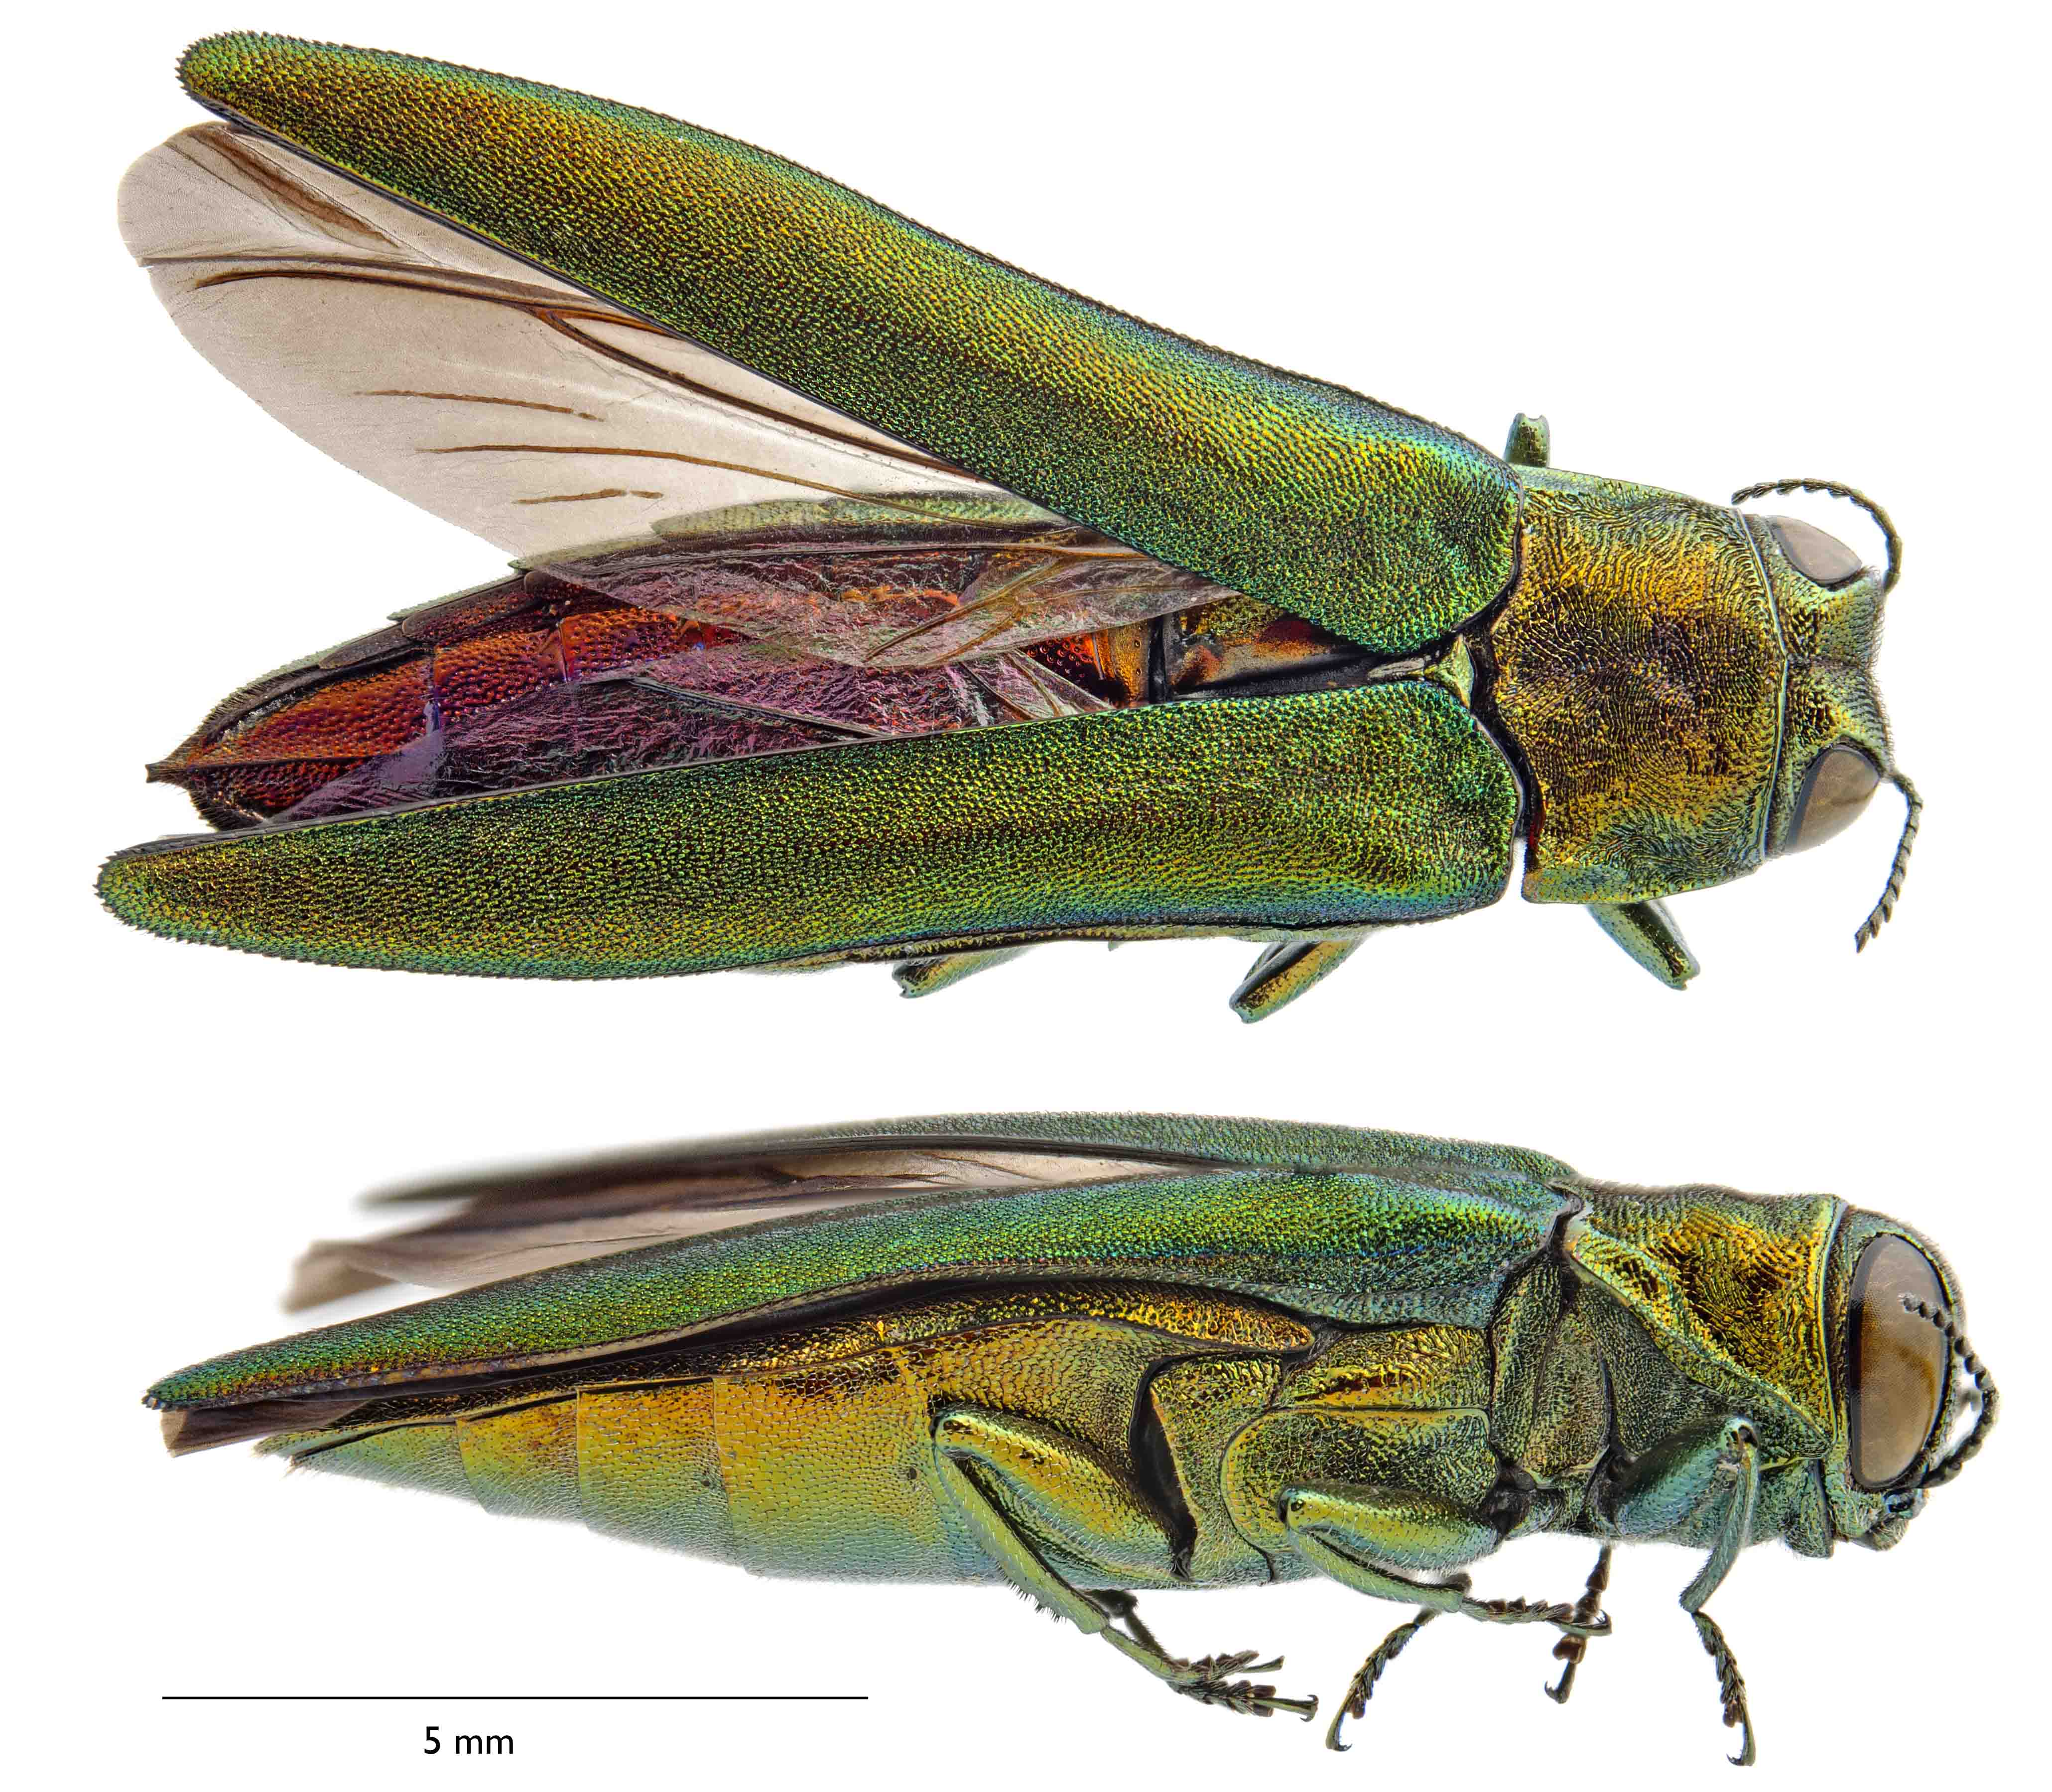
Female
Photo by
Kent Loeffler,
Cornell University

Slide 3
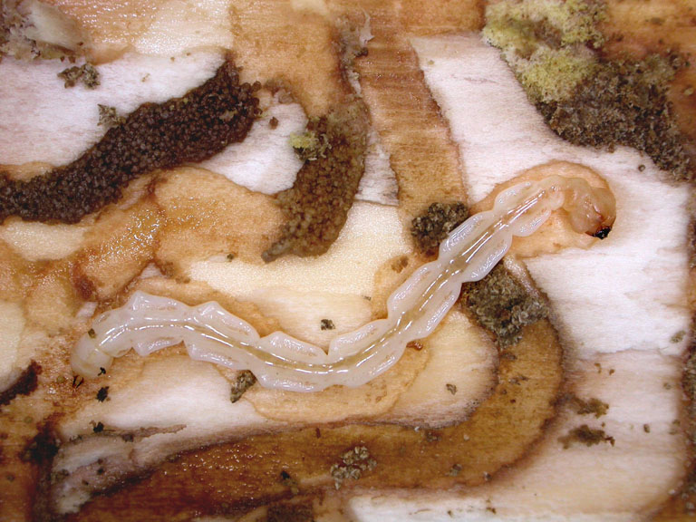
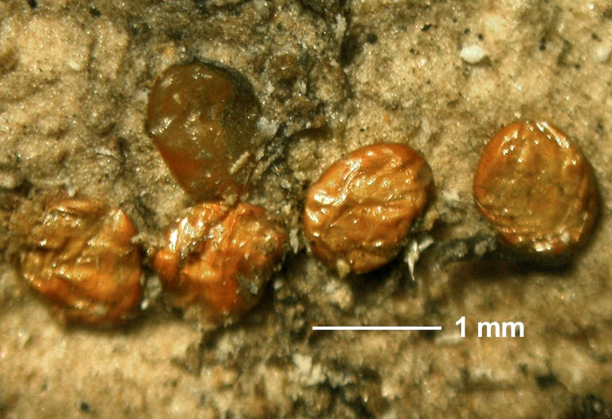
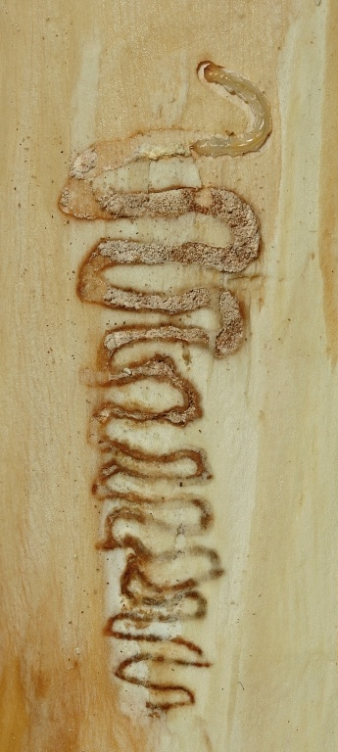
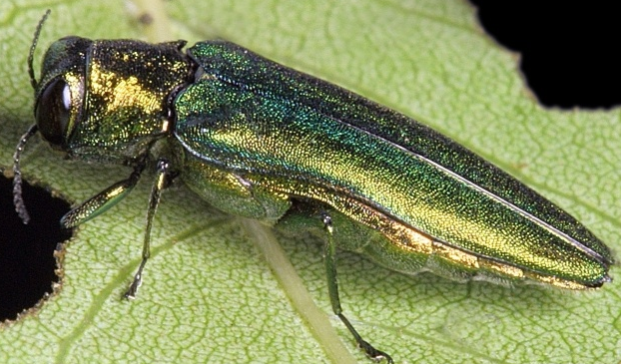
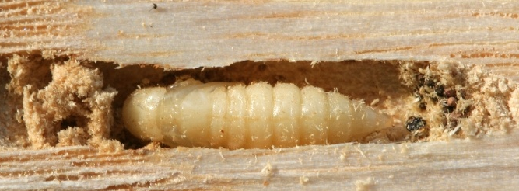
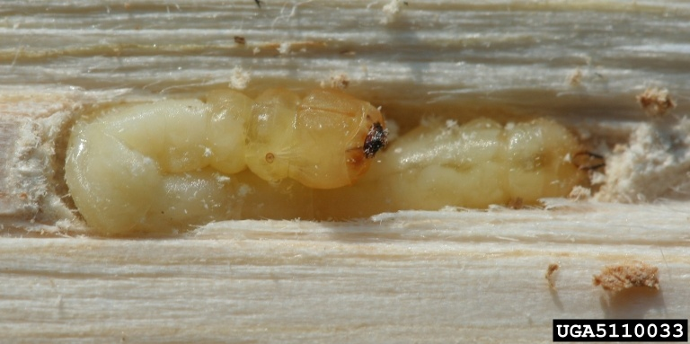
Summer/Fall
Larval growth
Winter
Pre-pupae
Early spring
Pupation
May/June
Adult Emergence
Ovary maturation
June/July
Oviposition
1-Year
Life Cycle

Slide 4
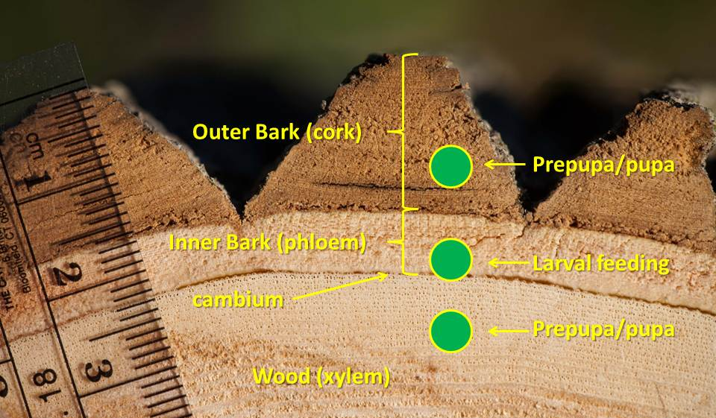
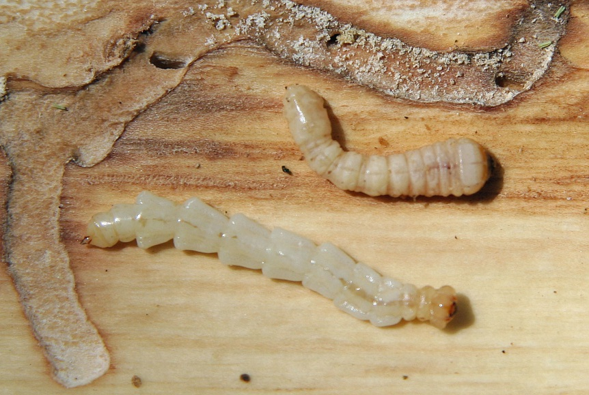
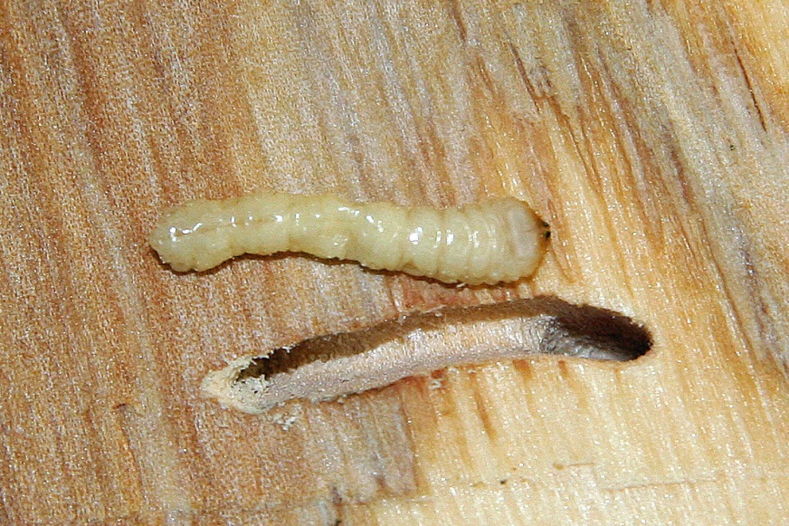
Red-headed Ash Borer
Neoclytus acuminatus
EAB larva:
Nested bells
Small head

Slide 5
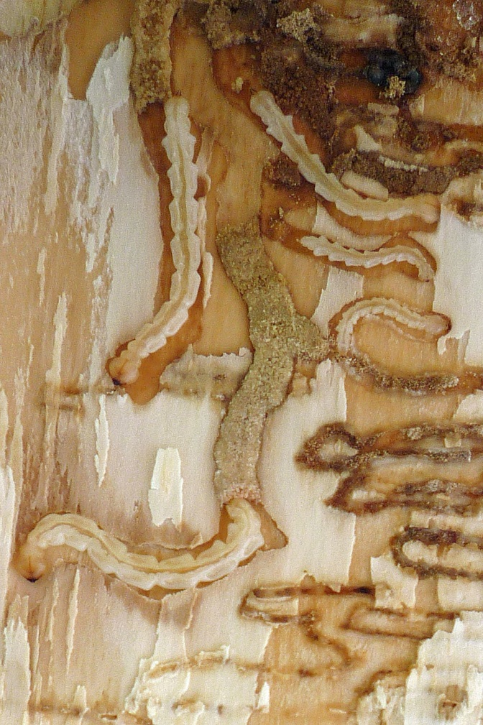
EAB Detection
EAB will not attack just one tree
Look at others in the vicinity
Use multiple symptoms in diagnosis
The ash in our area look like heck, it must be EAB
Ash decline is common in White ash growing on saturated soils – look for signs and symptoms.
Bugwood.org

Slide 6
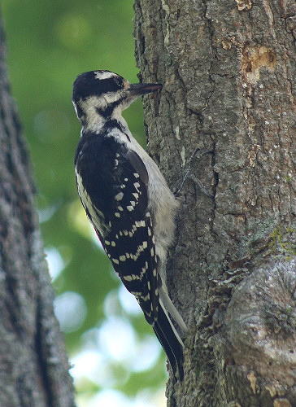
Visual Signs & Symptoms
Varies with Pest Pressure
Tier I: Early infestation
Bark Splitting
Woodpecker foraging
Tier II: Mid level infestation
Woodpecker foraging
Canopy thinning
Epicormic sprouting
Tier III: Heavy infestation
Canopy thinning
Woodpecker foraging
Epicormic sprouting
Bugwood.org

Slide 7
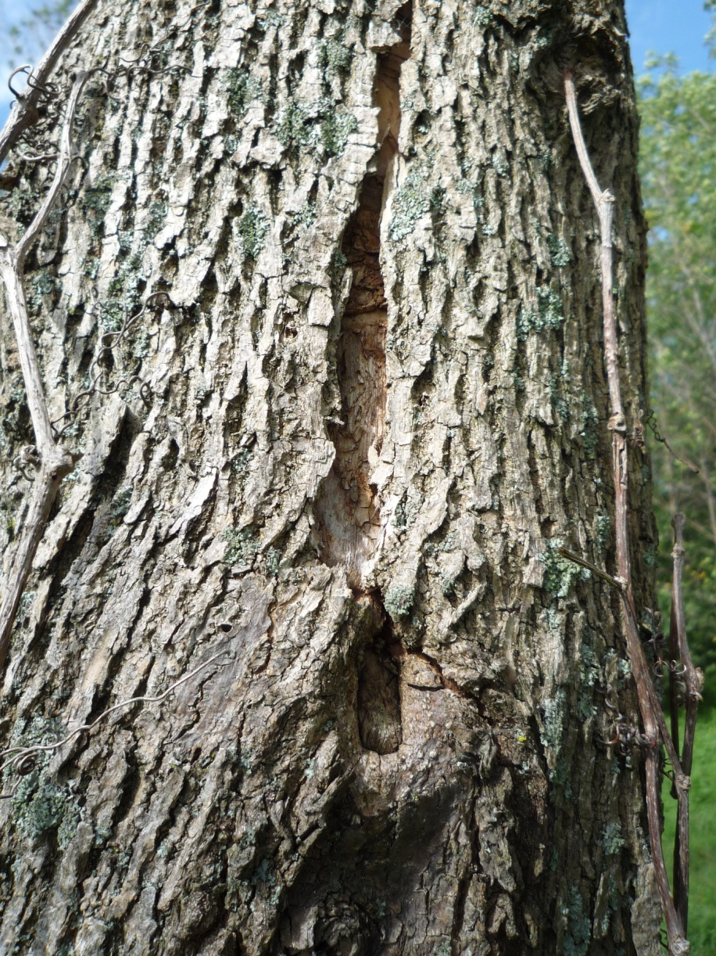
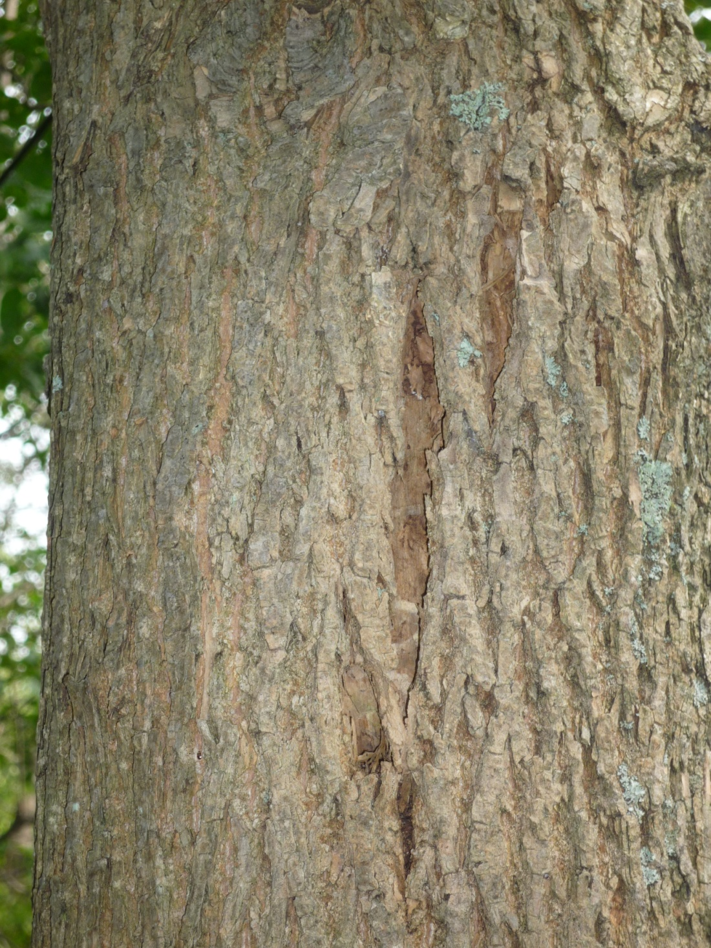
Bark splitting

Slide 8
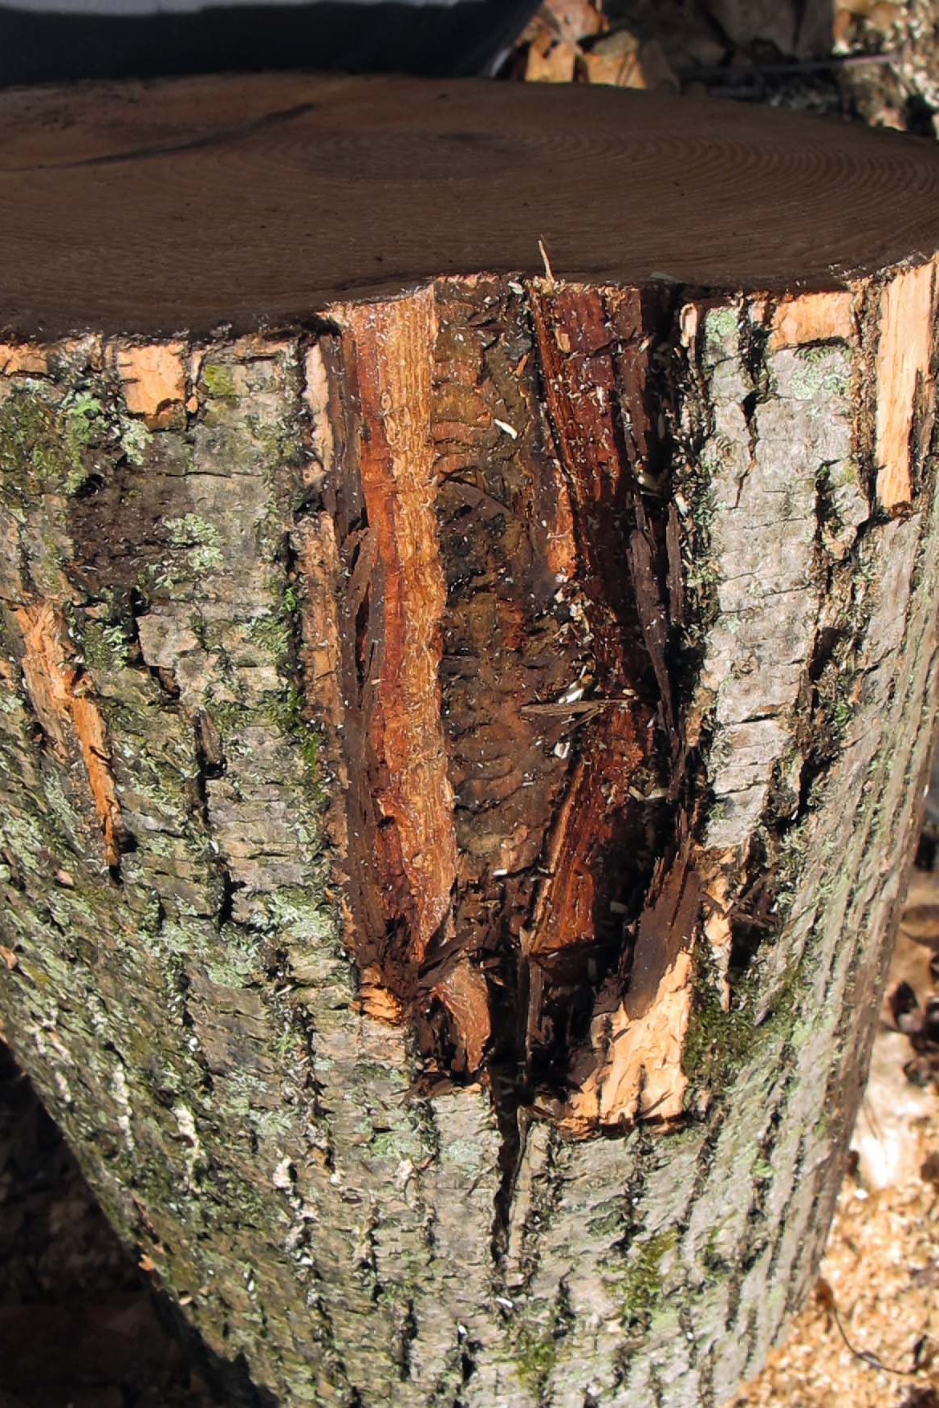
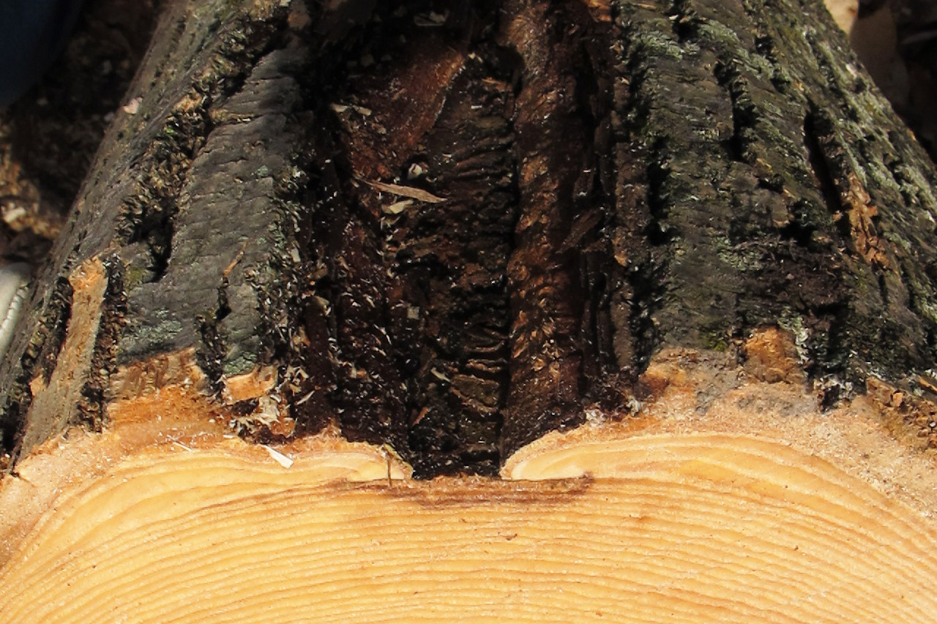
Bark splitting
5 year-old EAB wound

Slide 9
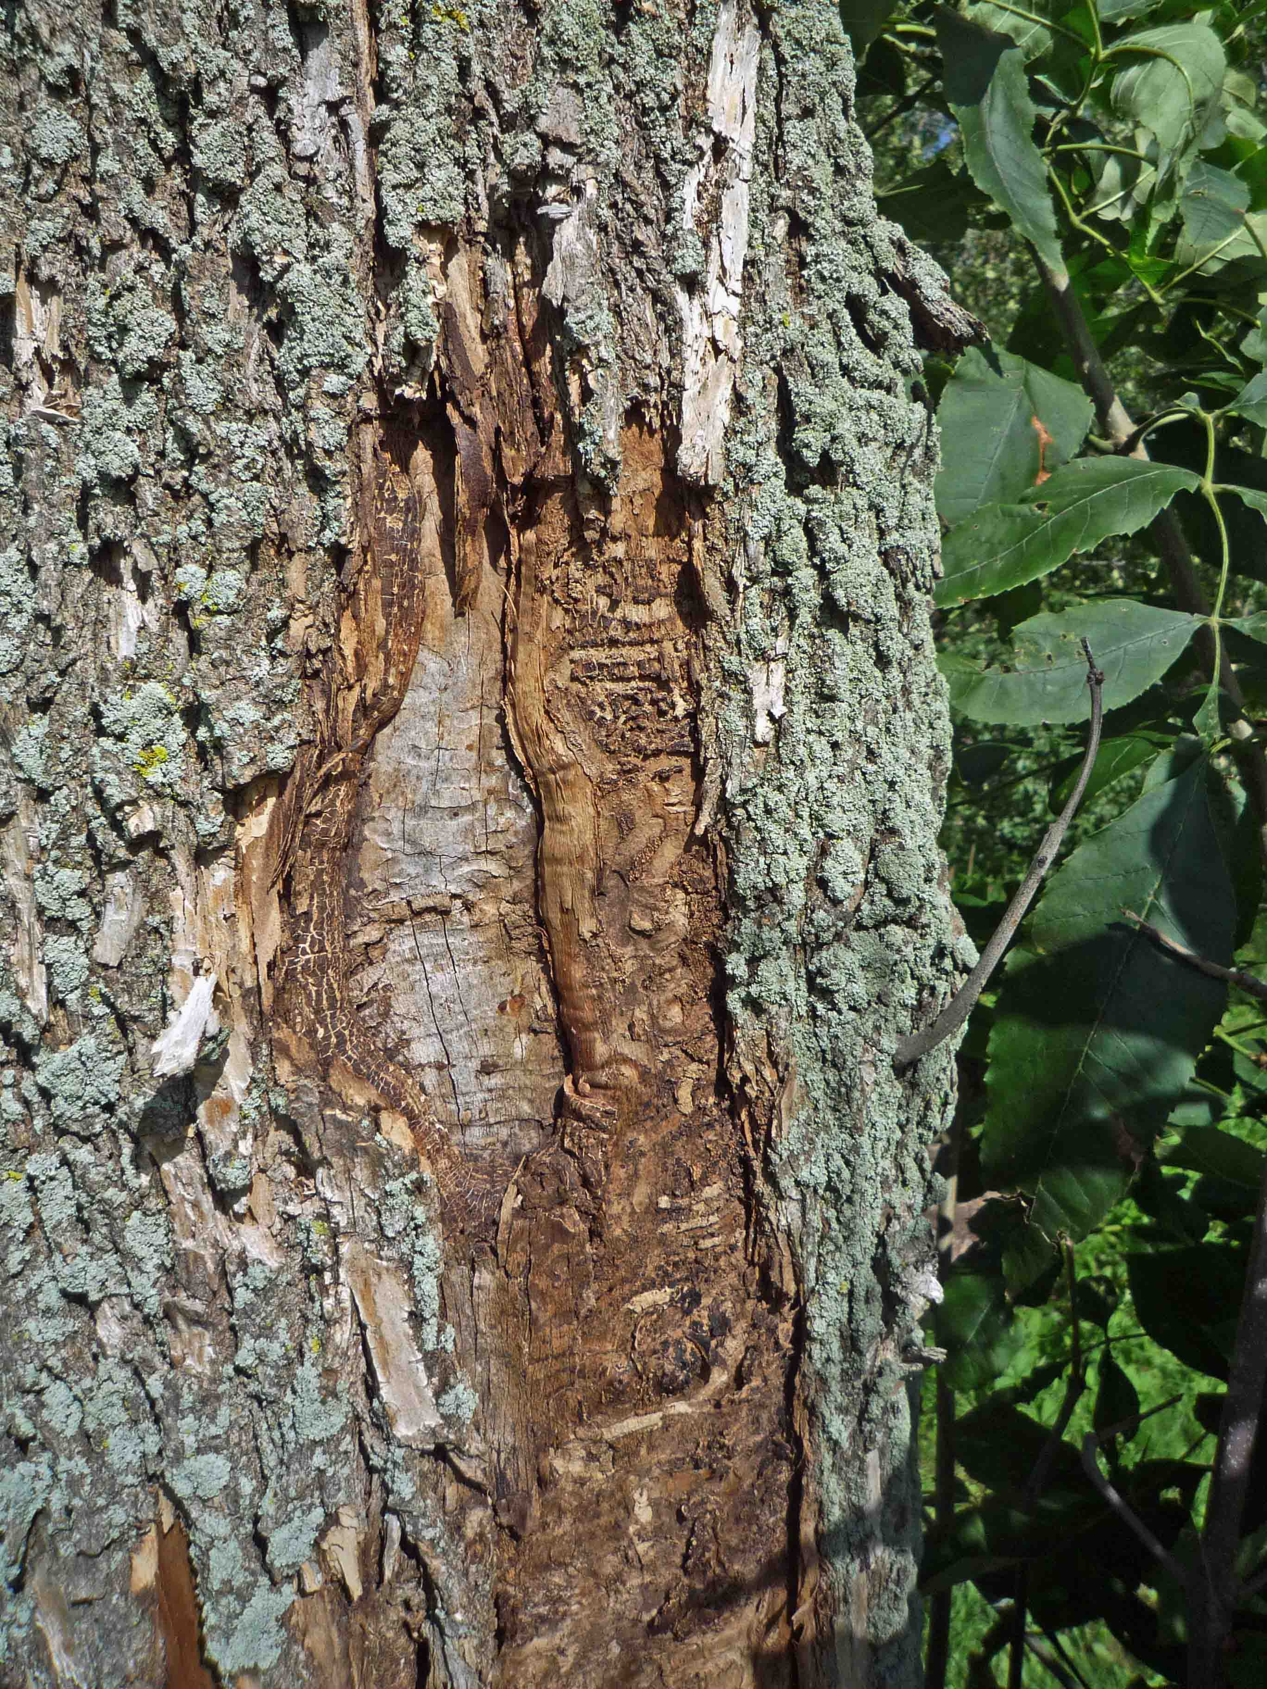
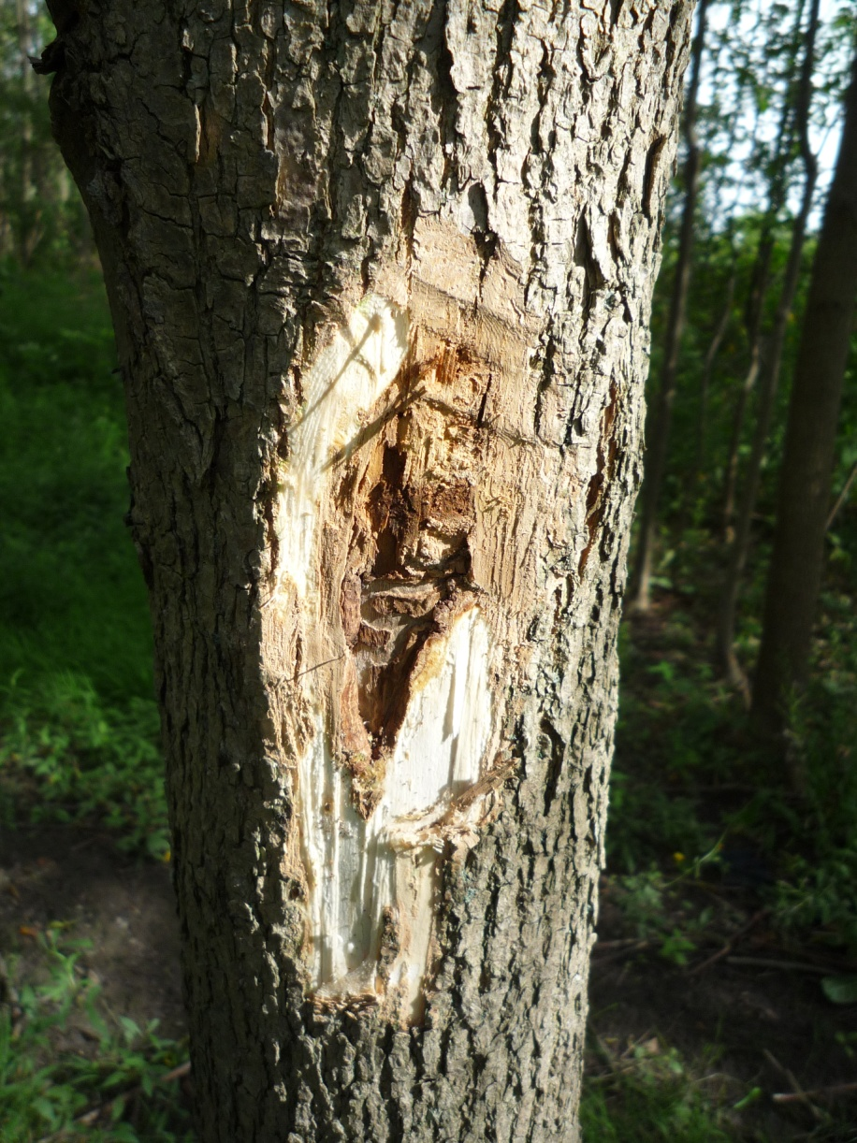
Bark splitting

Slide 10
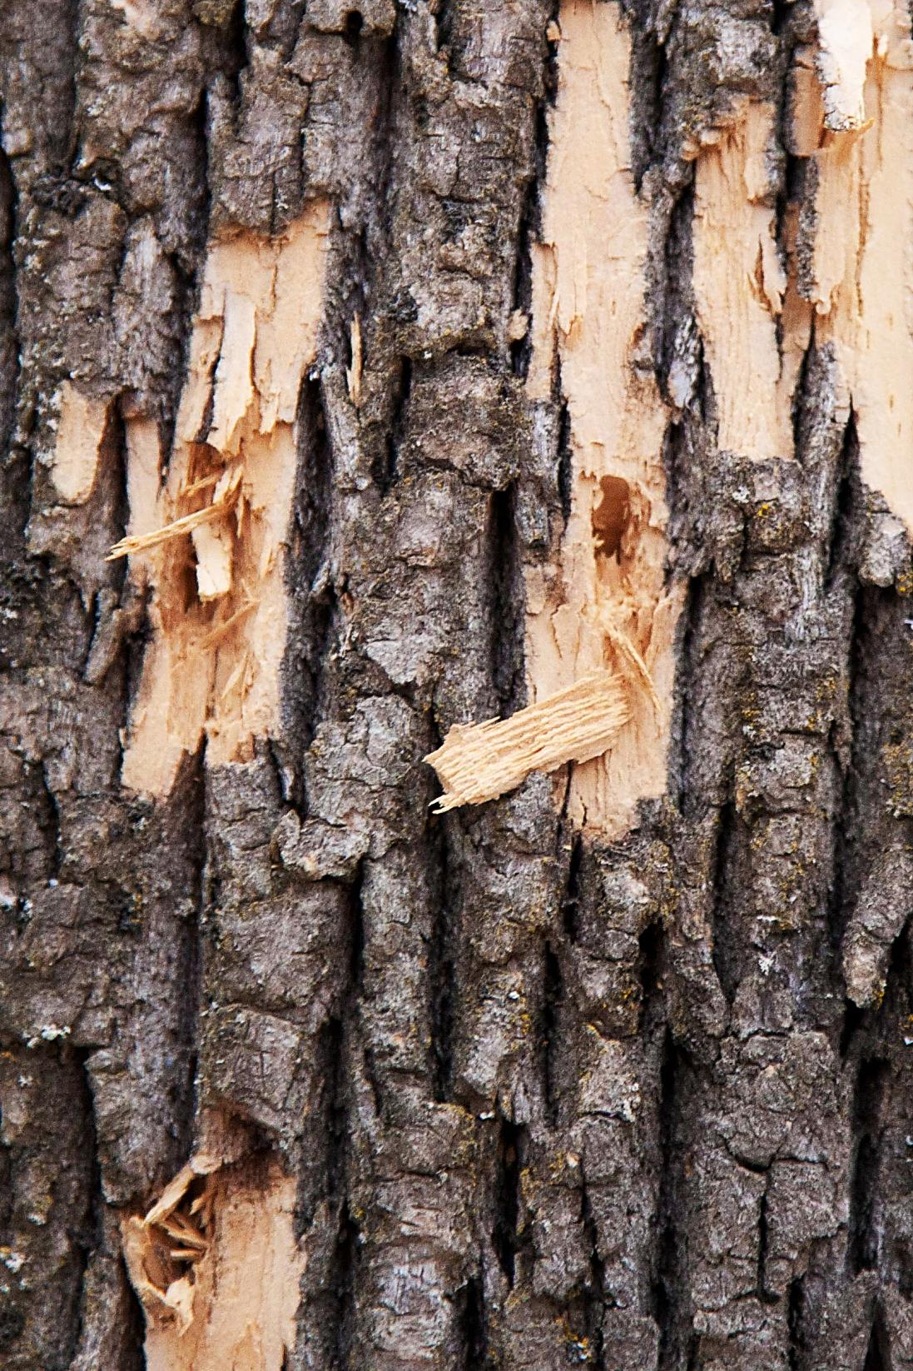

Slide 11
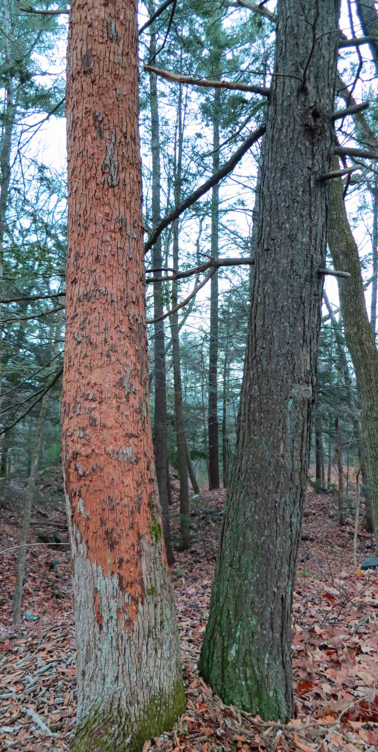
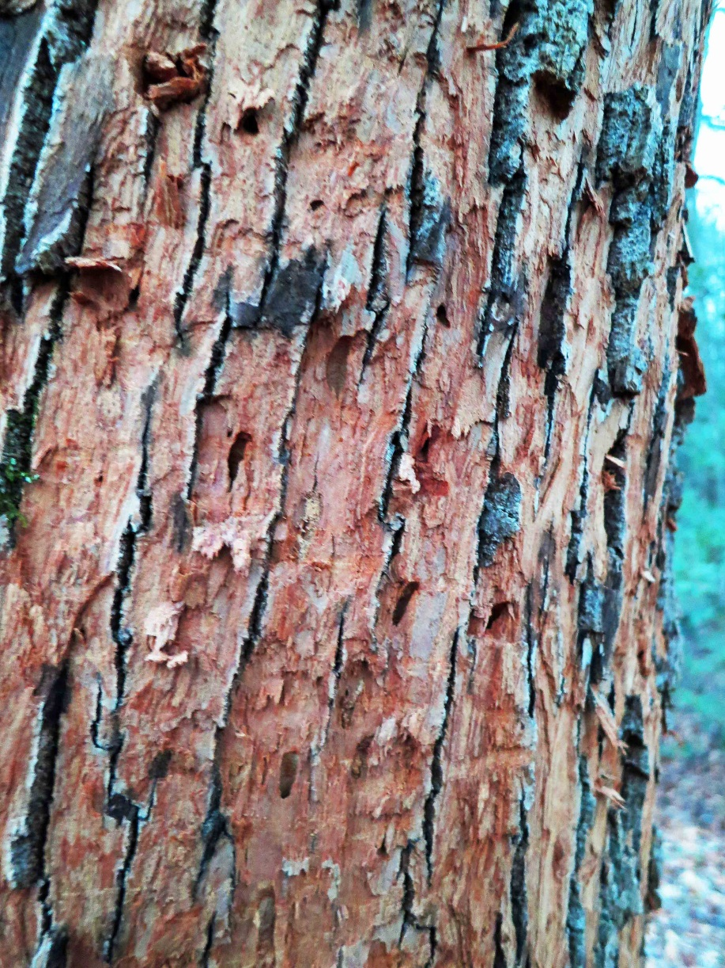

Slide 12
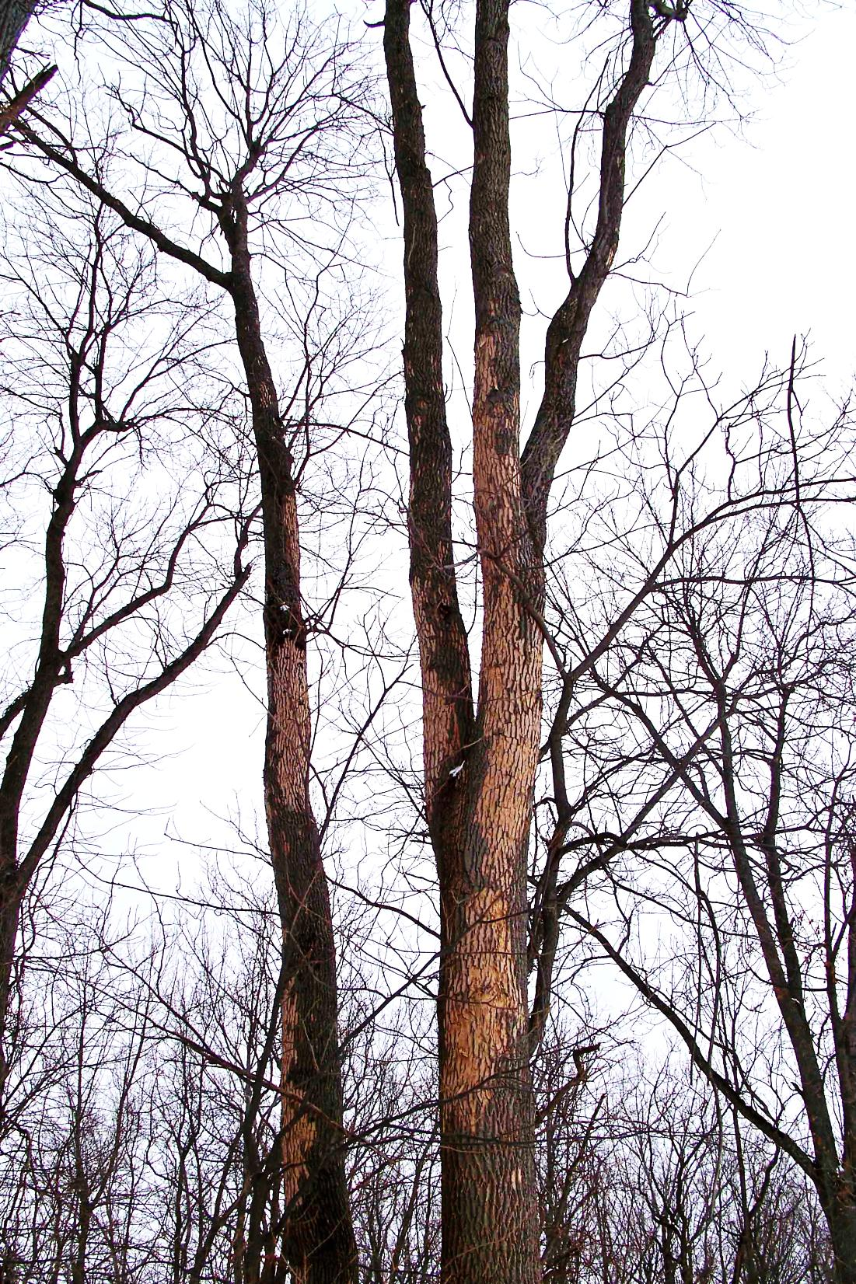

Slide 13
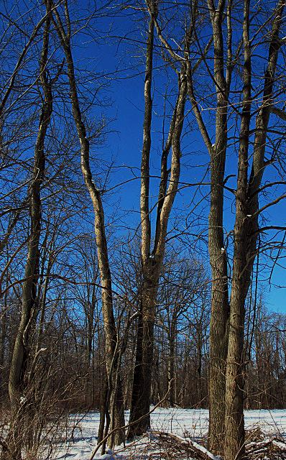
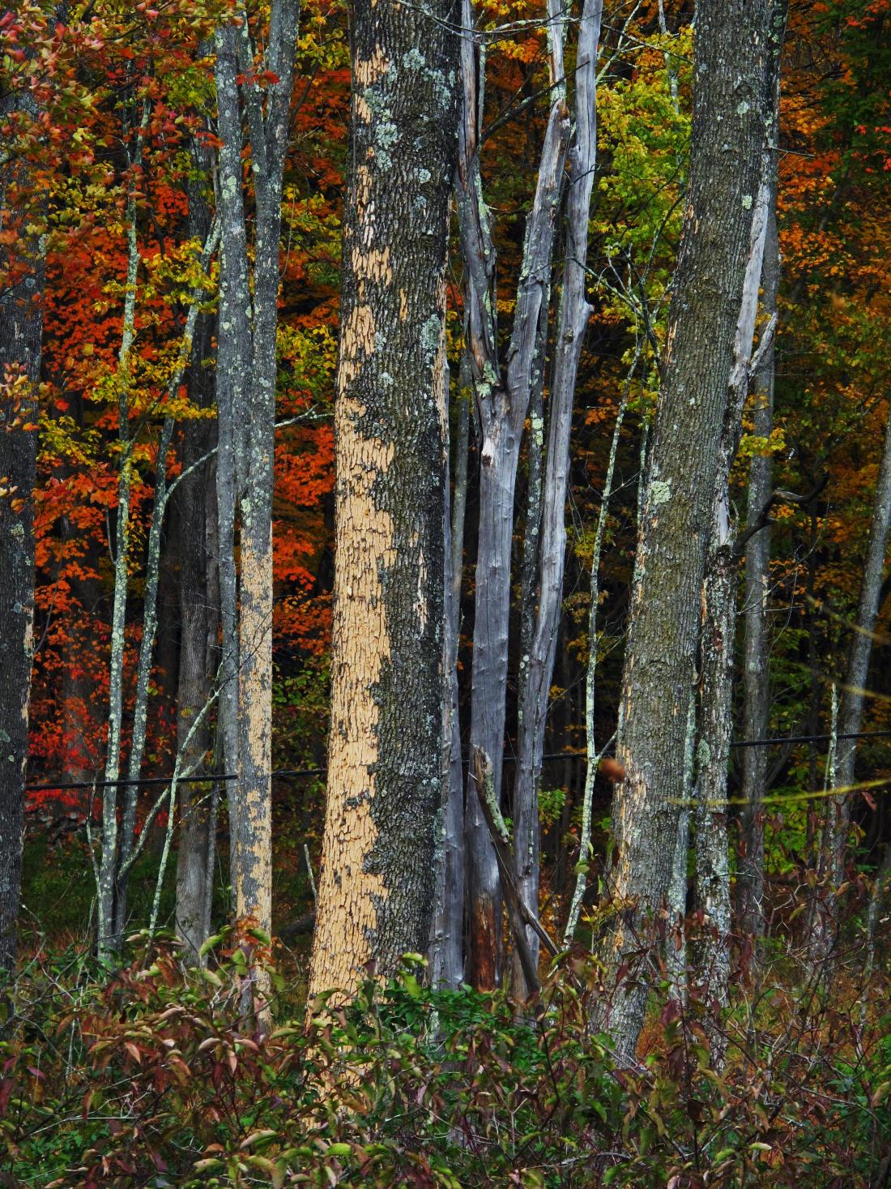

Slide 14
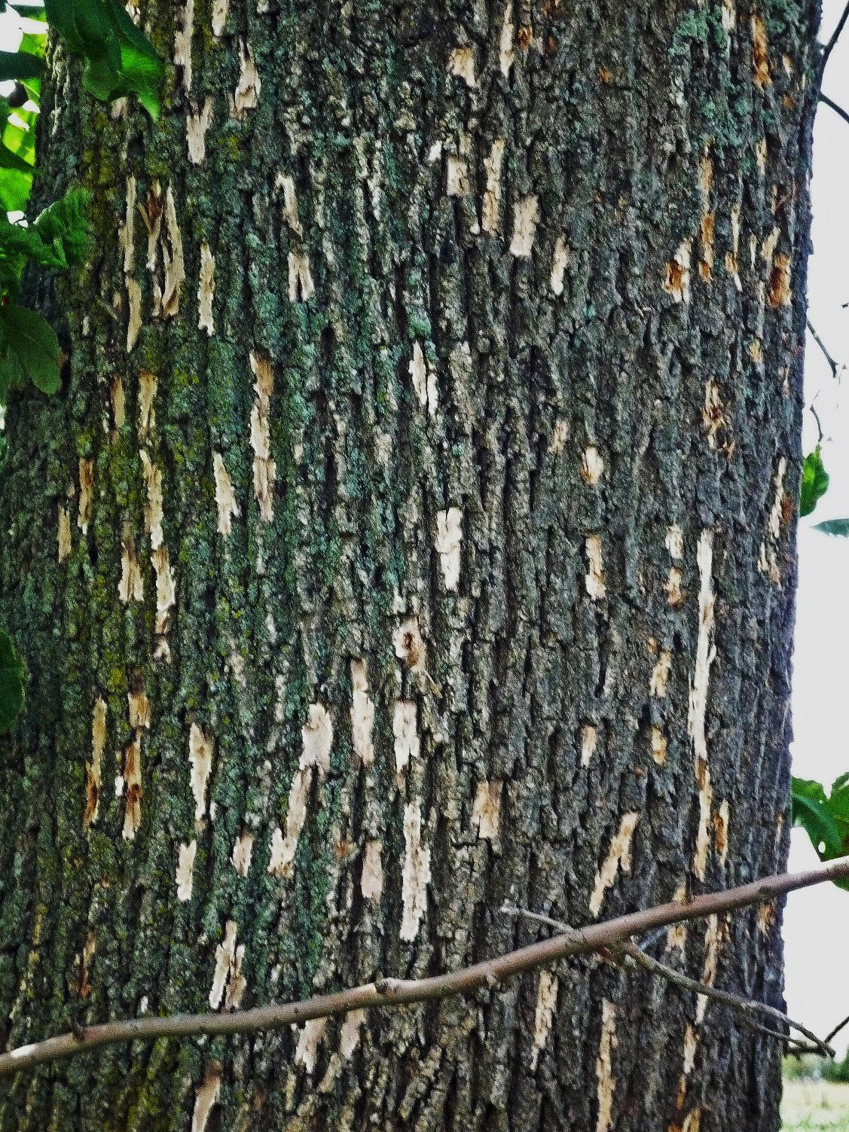
Red-headed Ash Borer
EAB

Slide 15
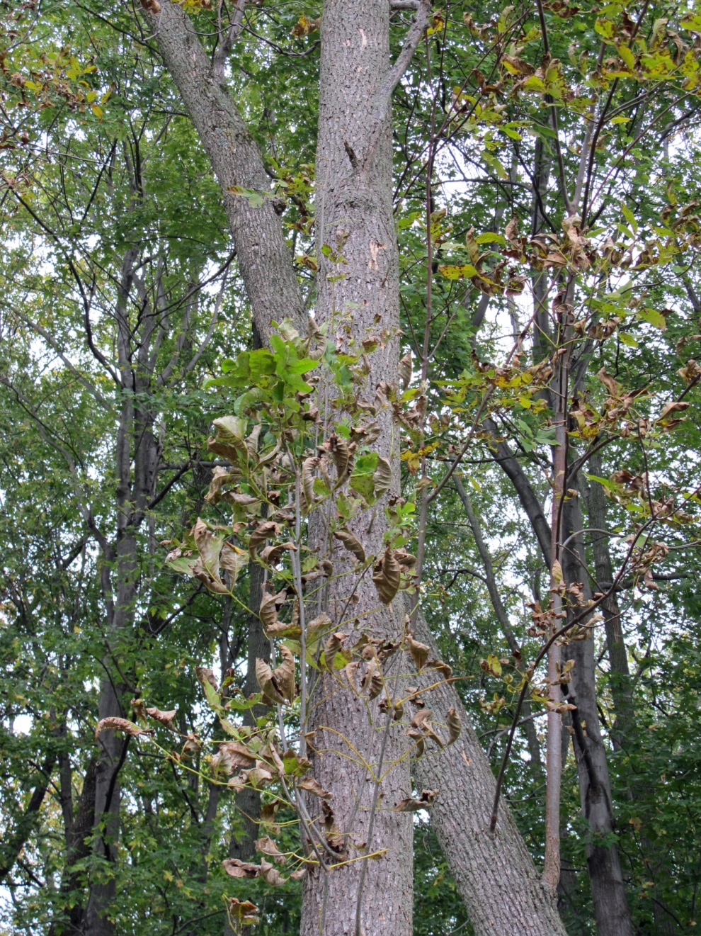
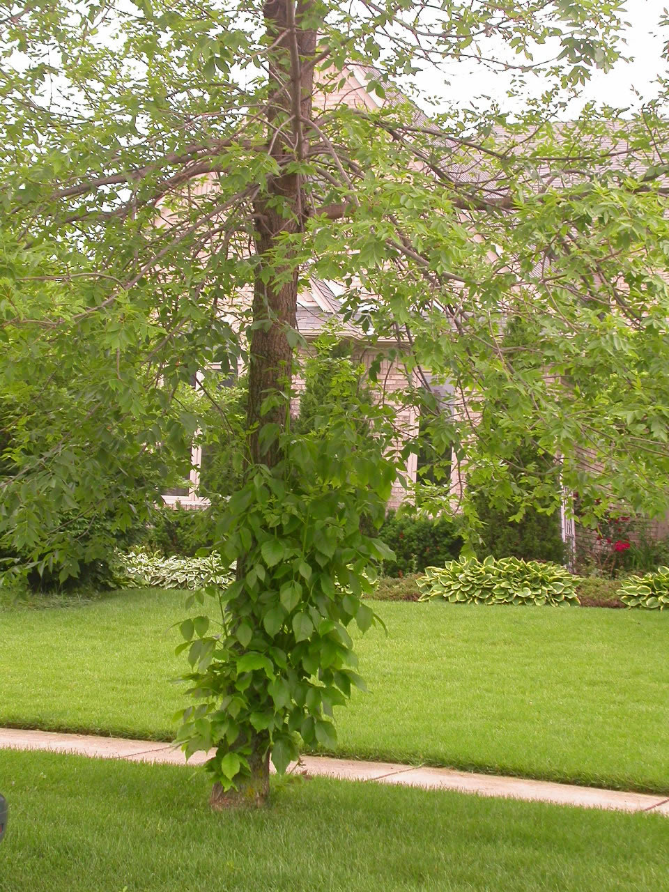
Signs & Symptoms
Epicormic, or water sprouts

Slide 16
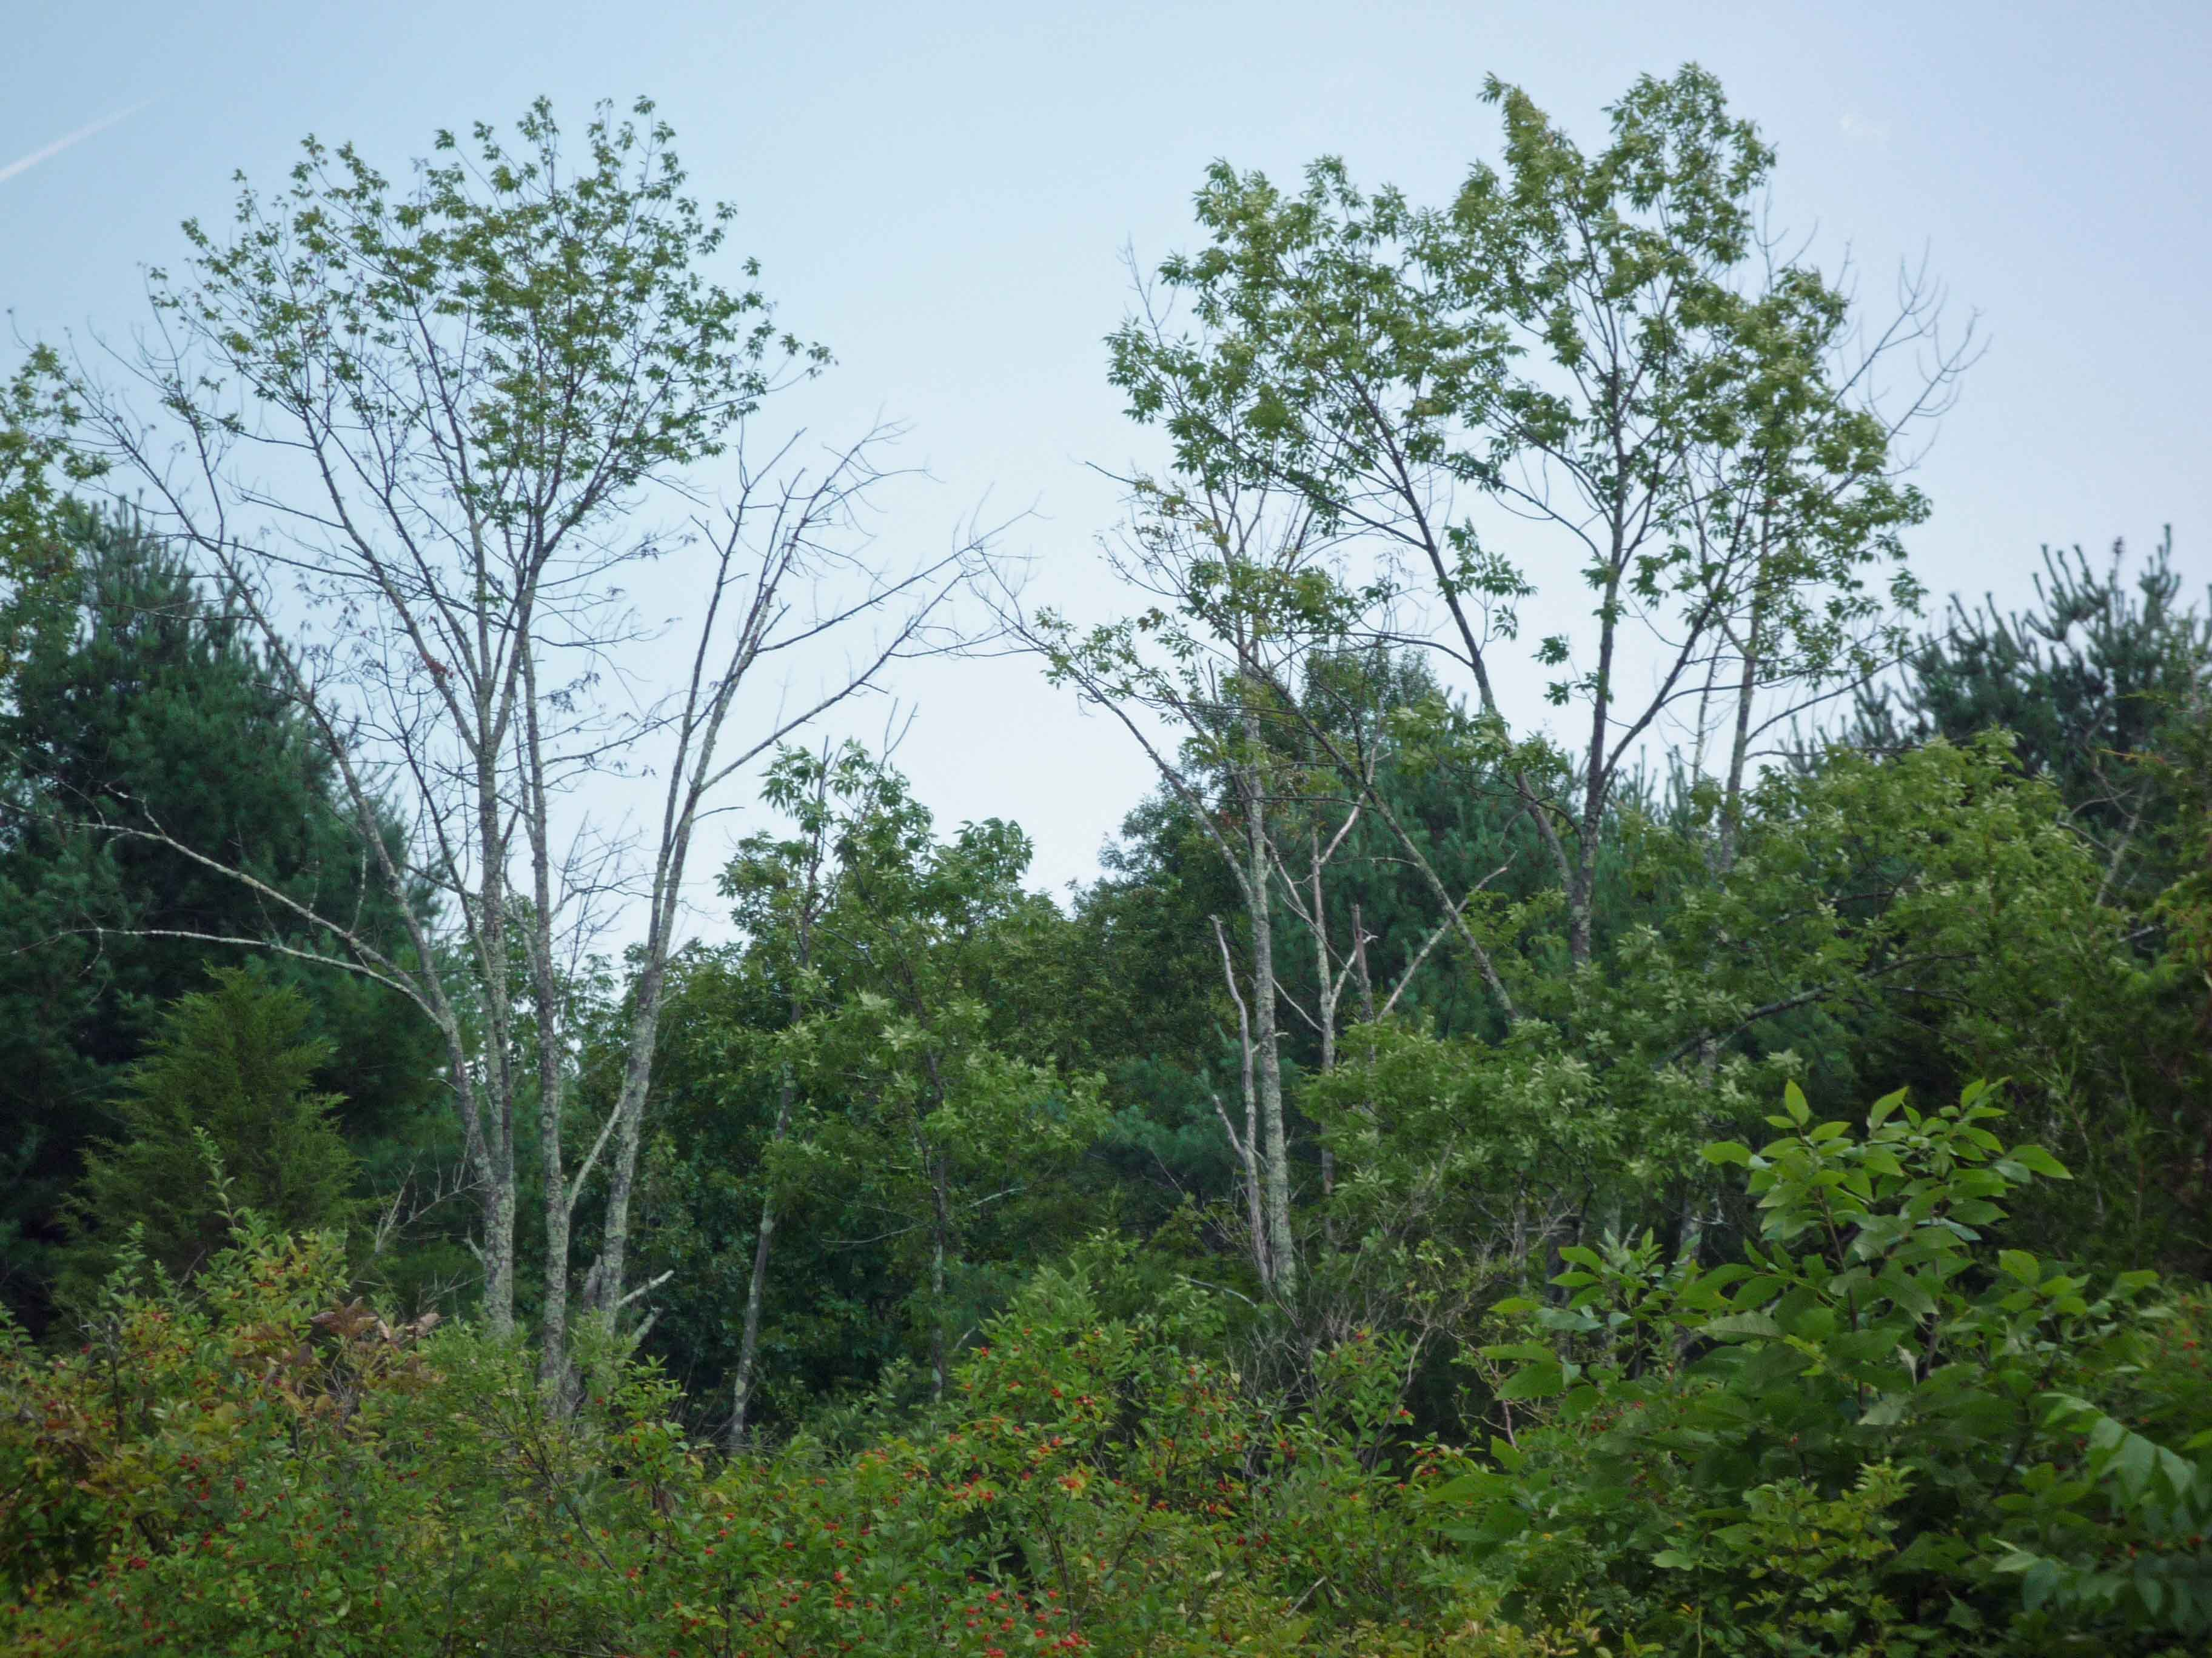
Signs & Symptoms
Canopy thinning

Slide 17
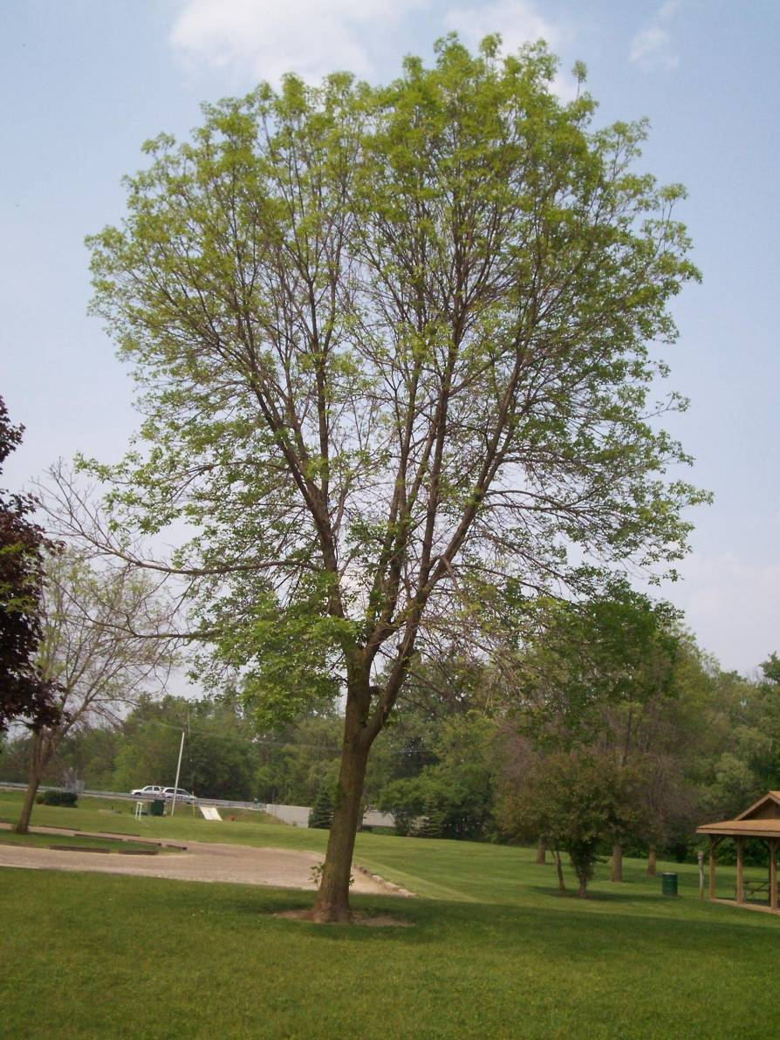
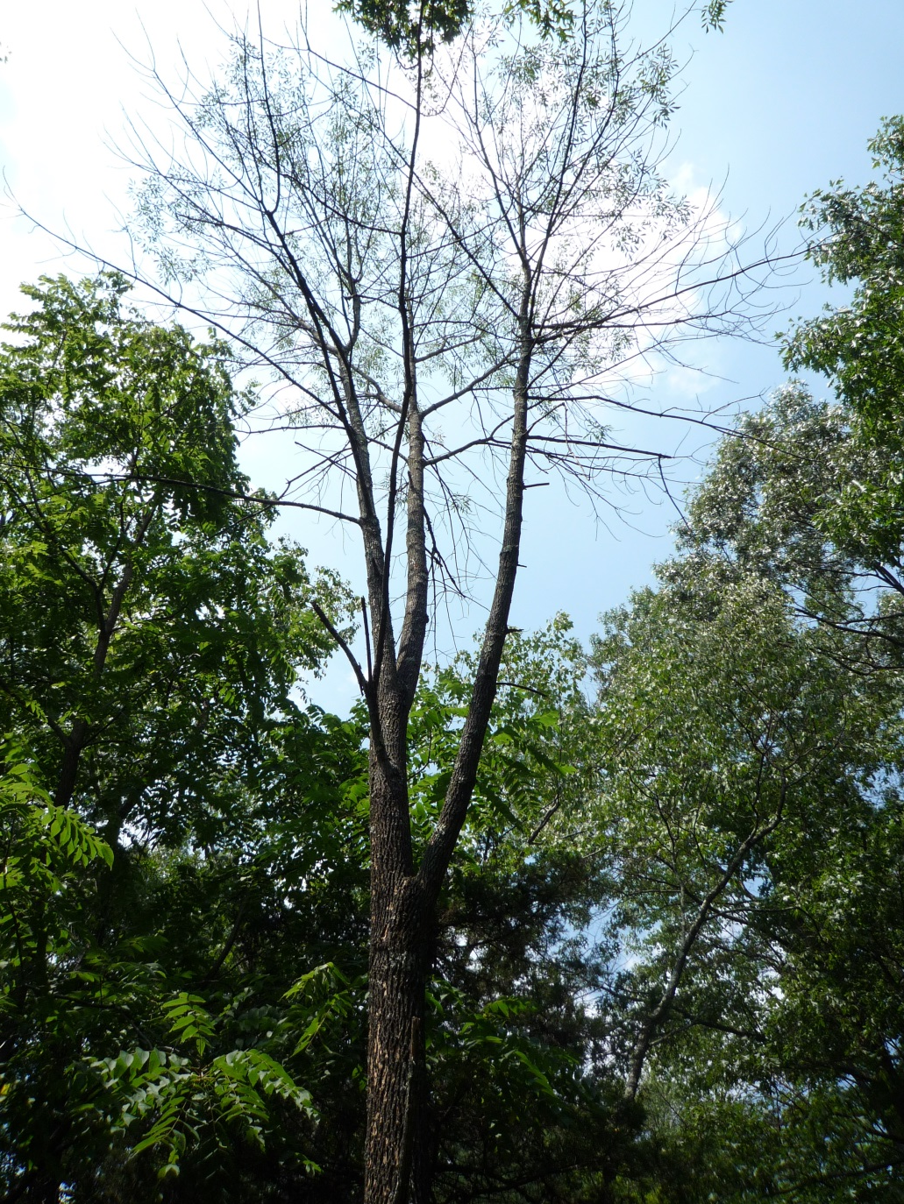
Signs & Symptoms
Is there a difference between urban and forest trees?

Slide 18
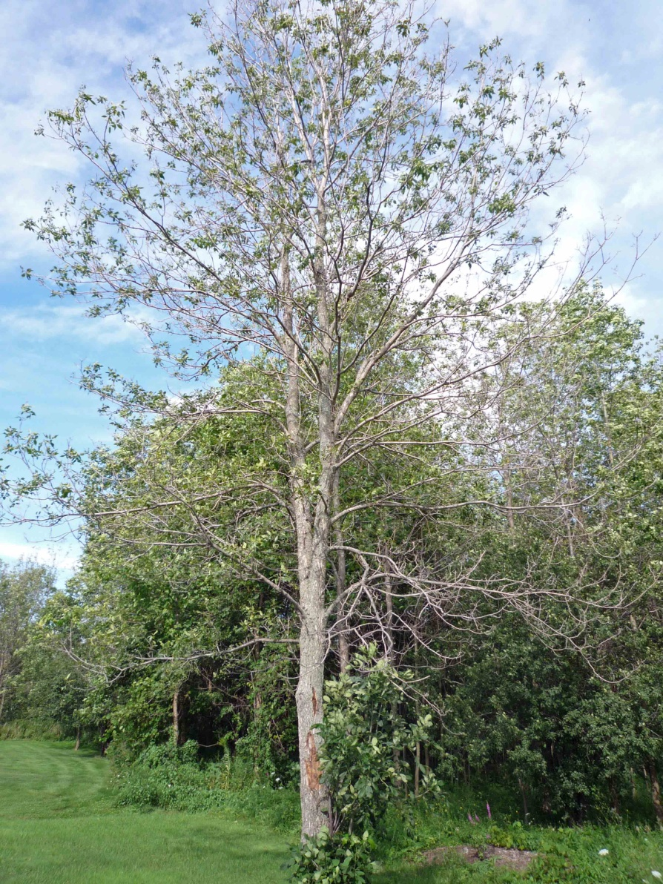
But it still has
green leaves!

Slide 19
Look, no phloem!

Slide 20
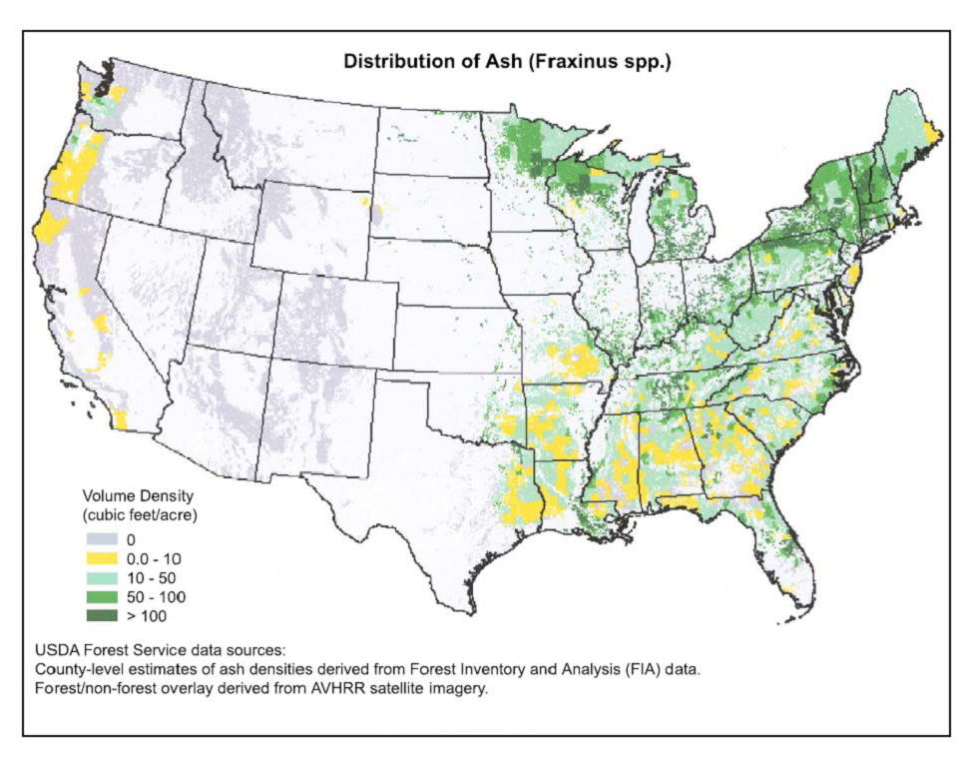

Slide 21
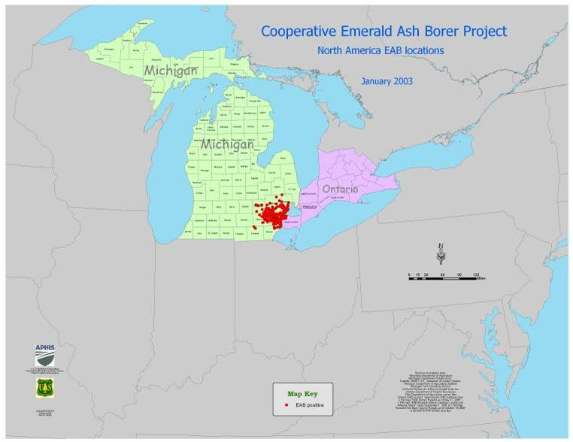
January 2003

Slide 22
May 2014

Slide 23
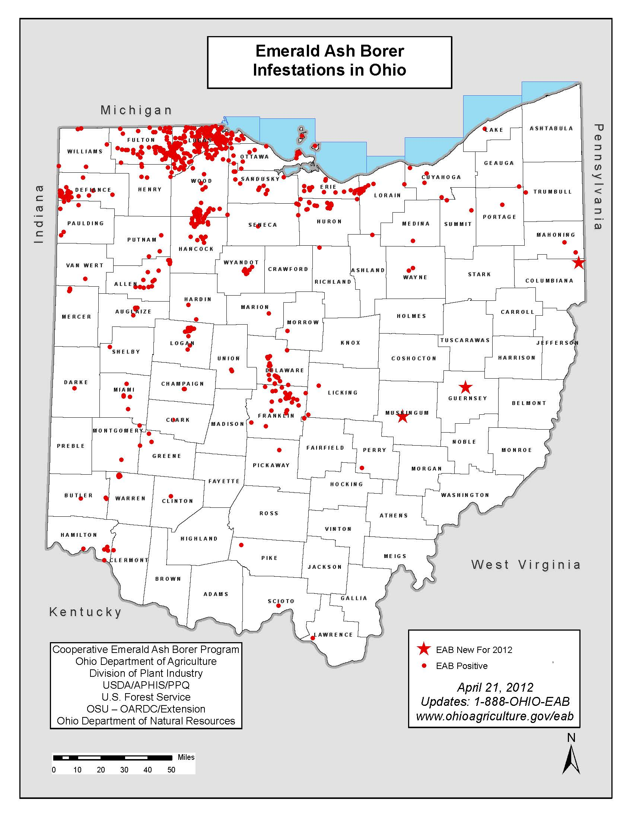

Slide 24
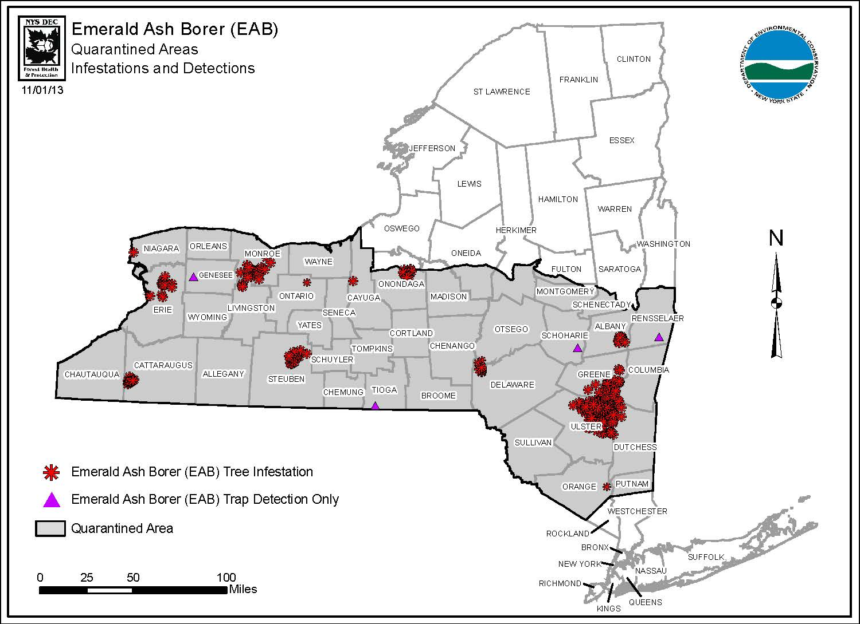
Less than 5% of NY forests are currently infested!

Slide 25
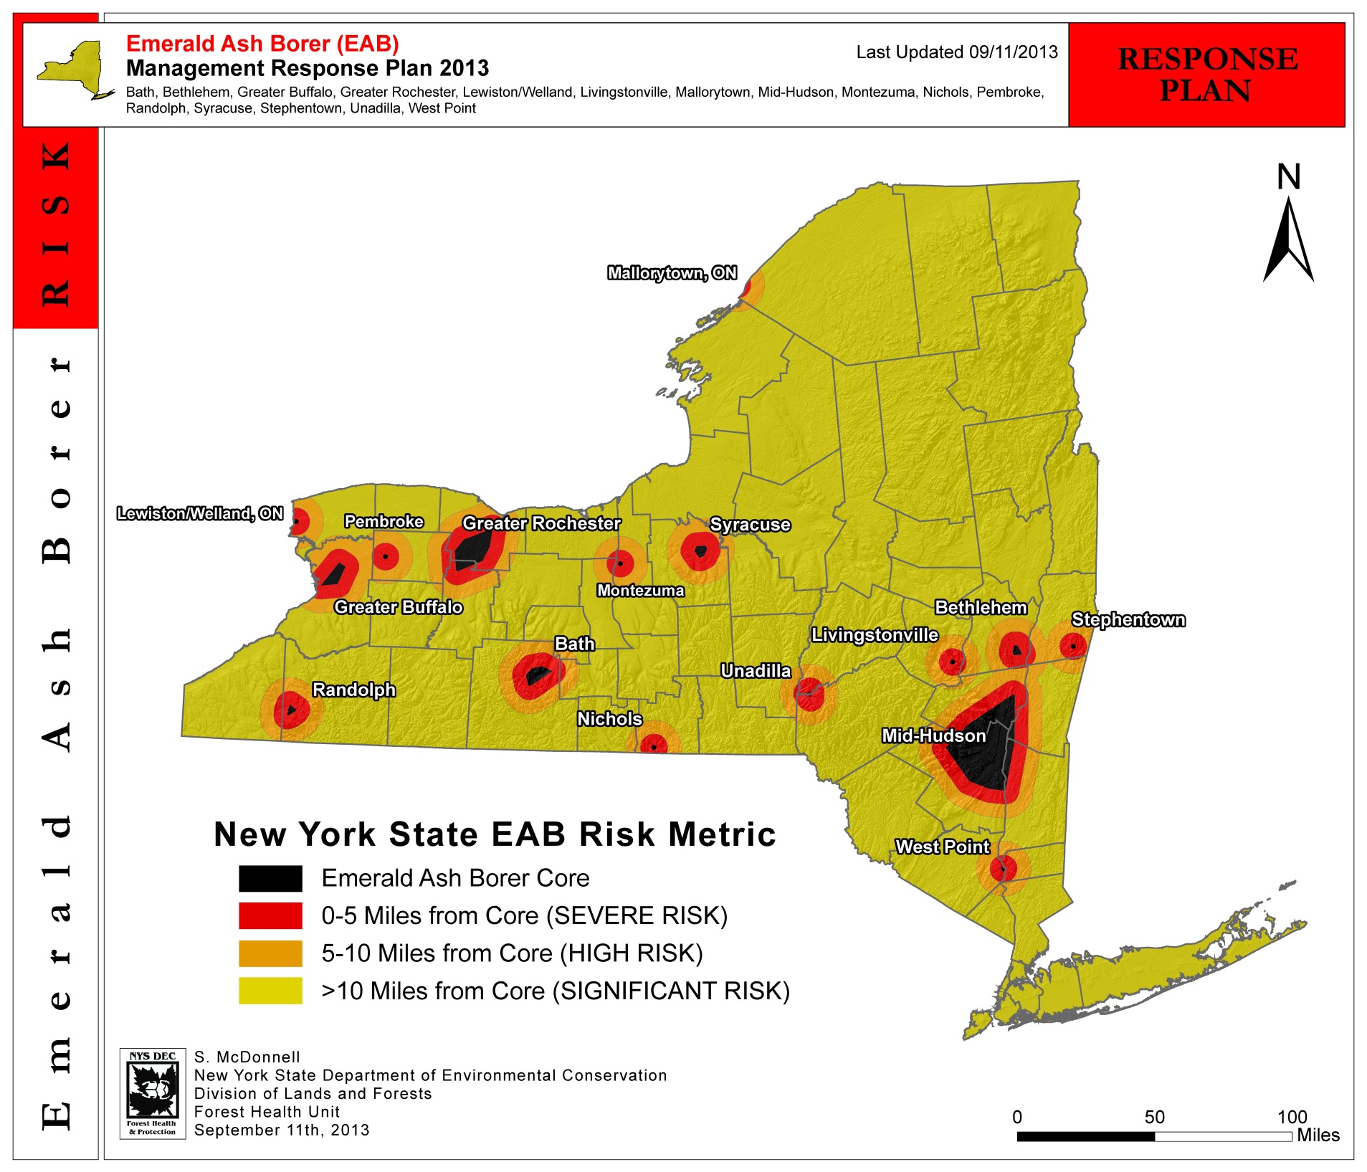

Slide 26
How Much of NY is Infested?
Black, "Core", area ("known-infested") = 513,358 acres, or 1.7% of NY State
Red, "Severe Risk" area = 1,607,892 acres, or 5.3% of NY State
The "actually-infested" area is STILL less than 2% of NYS, 4 and a half years into our "Statewide infestation".

Slide 28
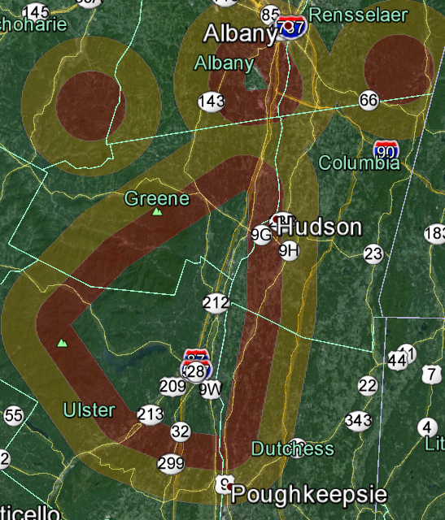

Slide 29
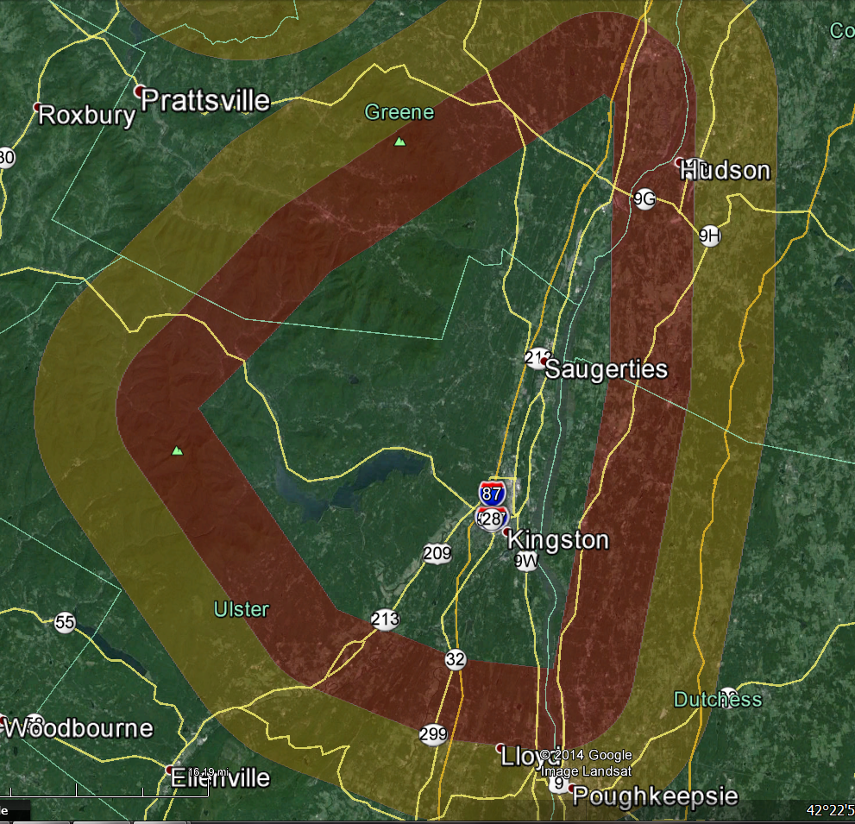

Slide 30
EAB Death Curve
Dan Herms, Ohio State University, 2012.

Slide 31
EAB Population Behavior
Depends on two basic factors:
Pest Pressure
Host tree density

Slide 32
EAB Population Behavior
Depends on two basic factors:
Pest Pressure
Host tree density
Pest Pressure = The number of bugs in one place at one point in time.

Slide 33
EAB Population Behavior
Depends on two basic factors:
Pest Pressure
Host tree density
Pest Pressure = The number of bugs in one place at one point in time.
Determines how quickly a tree will be killed
Lots of EAB or High Pest Pressure, death is 2 to 3 years
Few EAB or Low Pest Pressure, death can be 7 years or more

Slide 34
EAB Population Behavior
Depends on two basic factors:
Pest Pressure
Host tree density
Pest Pressure = The number of bugs in one place at one point in time.
Determines how quickly a tree will be killed
Lots of EAB or High Pest Pressure, death is 2 to 3 years
Few EAB or Low Pest Pressure, death can be 7 years or more
Determines the rate of spread in an infestation
Lots of EAB or High Pest Pressure, faster spread
Few EAB or Low Pest Pressure, slower spread

Slide 35
EAB Population Behavior
Host tree density
Determines the rate of population buildup
Determines the rate of spread in an infestation

Slide 36
EAB Population Behavior
Host tree density
Determines the rate of population buildup
Determines the rate of spread in an infestation
High ash density = lots of food in one place
Populations can rapidly build to create high pest pressure
Low ash density
Forces adults to search farther to find suitable host trees.

Slide 37
EAB Population Behavior
Pest Pressure Impacts Management Decisions
Pest detection
Difficult at Low Pest Pressure, but well worth the effort.
Different symptoms are apparent with varying pest pressure
At High Pest Pressure… You are way behind the curve.

Slide 38
EAB Population Behavior
Pest Pressure Impacts Management Decisions
Pest detection
Difficult at Low Pest Pressure, but well worth the effort.
Different symptoms are apparent with varying pest pressure
At High Pest Pressure… You are way behind the curve.
Treatment options
Timing of management decisions – the earlier the better.
Use the EAB Cost Calculator from Purdue University.

Slide 39
EAB Population Behavior
Pest Pressure Impacts Management Decisions
Pest detection
Difficult at Low Pest Pressure, but well worth the effort.
Different symptoms are apparent with varying pest pressure
At High Pest Pressure… You are way behind the curve.
Treatment options
Timing of management decisions – the earlier the better.
Use the EAB Cost Calculator.
Pesticide effectiveness varies with pest pressure
Only the best pesticides work at High Pest Pressure.
My dog can protect your tree if there are no EAB in the vicinity.

Slide 40
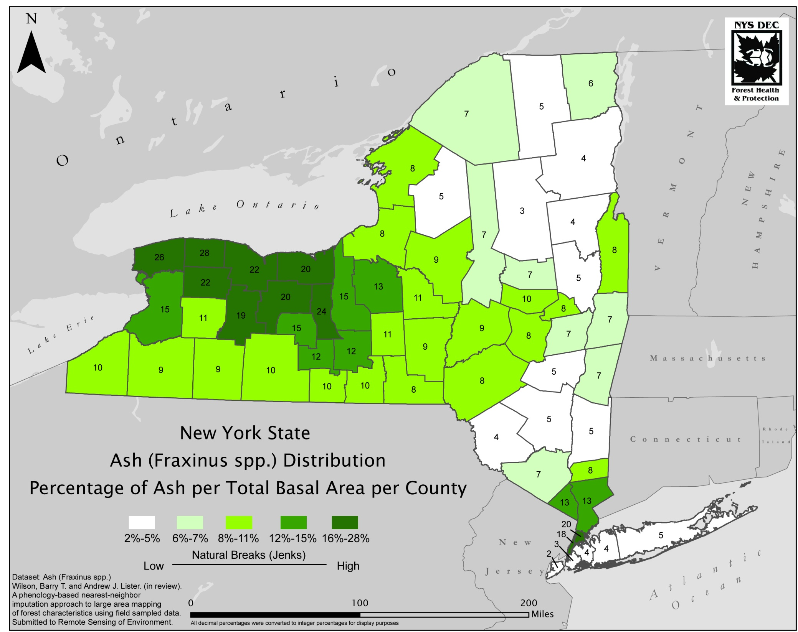

Slide 41
September 9, 2011
“We found that costs are largely borne by homeowners and municipal governments.”
“Wood- and phloem boring insects are anticipated to cause the largest economic impacts by annually inducing nearly $1.7 billion in local government expenditures and approximately $830 million in lost residential property values.”
“Given observations of new species, there is a 32% chance that another highly destructive borer species will invade the U.S. in the next 10 years.”

Slide 42
September 9, 2011
2.3% | 50.7% | 20.9% | 22.6% | 3.6%
2.6% | 48.4% | 21.6% | 23.6% | 3.7%

Slide 43
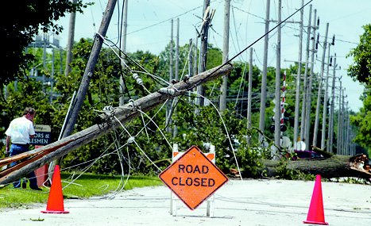
Power Transmission Lines in NYS
Total Miles of Transmission lines: 109, 358
Primary Distribution: 94,026
Sub Transmission: 6,706
Transmission: 5,150
TOTAL VULNERABLE: 105,885 miles of transmission lines
This estimate does not include lines going to homes or along driveways.
National Grid estimates there are about 242 trees/mile along their lines = 26,000,000 total trees
Conservative estimate is that 20% are Ash = 5,000,000 ash trees
Conservative estimate of tree removal by National Grid is $300/tree = $1,540,000,000

Slide 44
Natural Control of Insect Populations
Host Tree Resistance
Many factors involved, most poorly understood for trees
Abiotic Factors
Temperature, humidity
Biological Control
Predators, Parasites, and Pathogens
Additive effect of all agents involved

Slide 45
EAB and Cold Weather
Ontario study suggests cold causes very little mortality until the insect actually freezes. Sobek et al. 2009
Cold mortality study in two Minnesota sites. Venette and Abrahamson 2011.
-17.8°C (0°F), 5% will die
-23°C (-10°F), 34% will die
-29°C (-20°F), 79% will die
-34°C (-30°F), 98% will die
Tolerance of low temperatures genetically linked?
This question has yet to be answered.

Slide 46
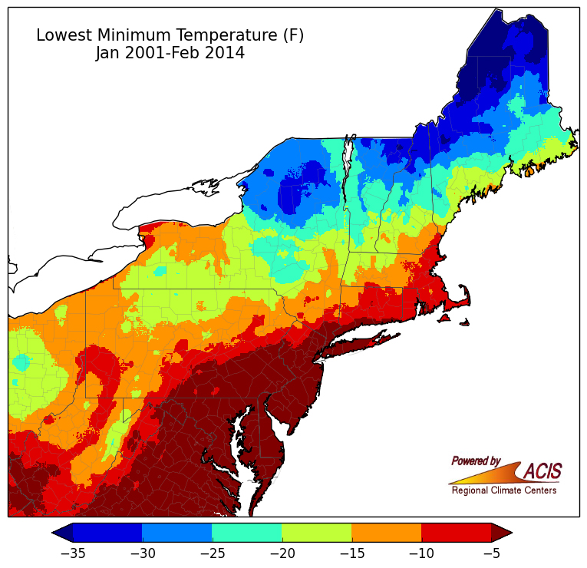
Northeast Regional Climate Center, Cornell University, 2014

Slide 47
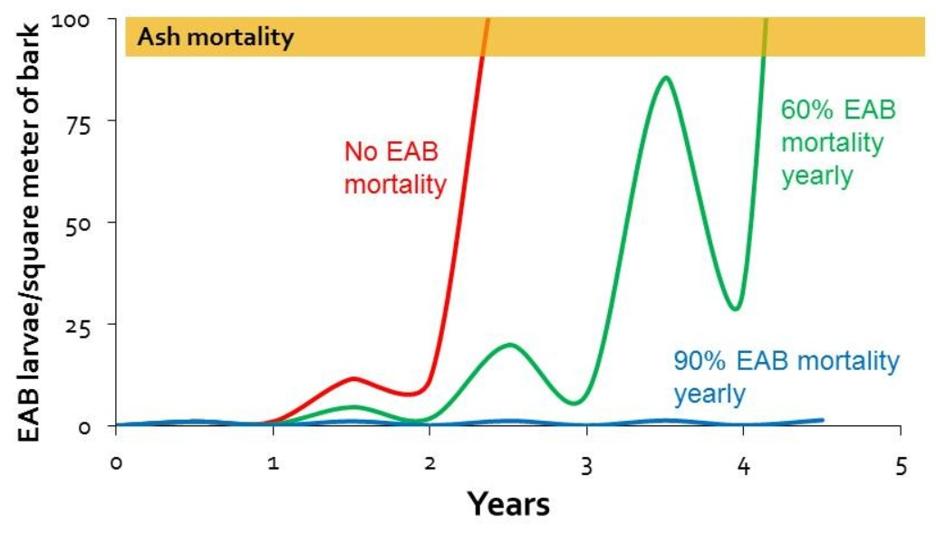
Rob Venette, USDA Forest Service 2014

Slide 48
What are MY objectives?
Restore ALL ash species to the North American landscape.
Mitigate the Economic Impacts of Emerald Ash Borer.

Slide 49
Restore Ash on Landscape
The 3 point plan
Establish Biological Controls
Identify and incorporate resistance
Conserve the ash genome

Slide 50
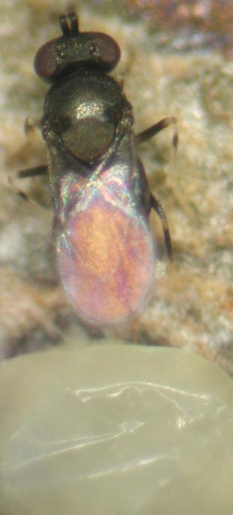
EAB Biological Control
Classic Biocontrol from Eastern Asia
Egg Parasitiod
Oobius agrilli
Larval parasitoids
Tetrastichus planipennisi – gregarious endoparasitoid
Spathius agrili – gregarious ectoparasitoid
Spathius galinae – Russia - not approved by EPA yet.
Native Biocontrol
Larval Parasitoids of wood-borers
Spathius floridanus (Hymenoptera: Braconidae)
Atanycolus spp. (Hymenoptera: Braconidae)
Predators
Enoclerus sp. (Coleoptera: Cleridae)
Woodpeckers!

Slide 51
Ash Resistance to EAB
Chemical and genetic work underway to identify mechanisms of resistance
Crosses with Asian species and back-crosses are being made now.
Similar to the technique used for American Chestnut
Lingering ash project
Identify individuals that seem to survive

Slide 52
Conserve ash genome
Collect seed
Federal, regional, and state programs underway
Must act fast to preserve the breadth of the genetic diversity across the landscape
Preserve magnificent individuals
Systemic insecticides

Slide 53
Mitigate Economic Impacts
Proactive planning
Tree inventories/ EAB Cost Calculator
Identify priorities for management
Engage communities
Inter-municipal cooperation
Develop novel management techniques
Pesticide treatments
Wood utilization

Slide 54
Management Options
Do nothing
Liability issues
Remove all ash before they become infested
Loss of valuable canopy
Remove ash as they become infested
Expensive reactive management – potential exposure to liability
REMEMBER THE DEATH CURVE!!!
Treat with insecticides
Retain canopy
Many management options available with more time

Slide 55
Systemic Insecticides for EAB
Imidacloprid (Merit, Xytect, and others)
Must be used annually
Spring and Fall applications effective
Fall application needs 2x formulation
Dinotefuran (Safari)
Must be used annually
Spring and early Summer application only
Efficacy falls off with later instar larvae
Rapid uptake with basal bark application, no soil application in NYS.
No need to use surfactant
Emamectin benzoate (Tree-äge)
Spring and Fall application
Most effective product under highest pest pressure
Recent unpublished research has demonstrated that in younger trees (<18 in. DBH) it is effective for up to 3 years at 0.4g ai/in. DBH.

Slide 56
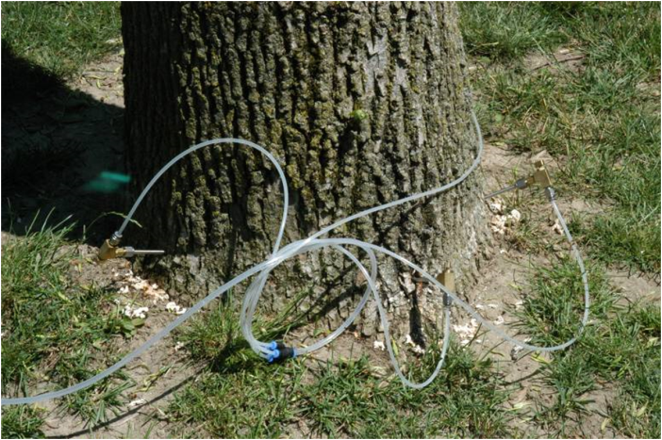
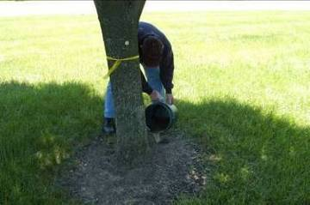
Trends in Three Product Delivery Systems Used to Manage EAB in North America 2004-2013
Data from urban and peri-urban sample sites in north America based on annual end of season
assessments: Anand B. Persad The Davey Institute , Kent OH 2013 (n = 40 sites )

Slide 57
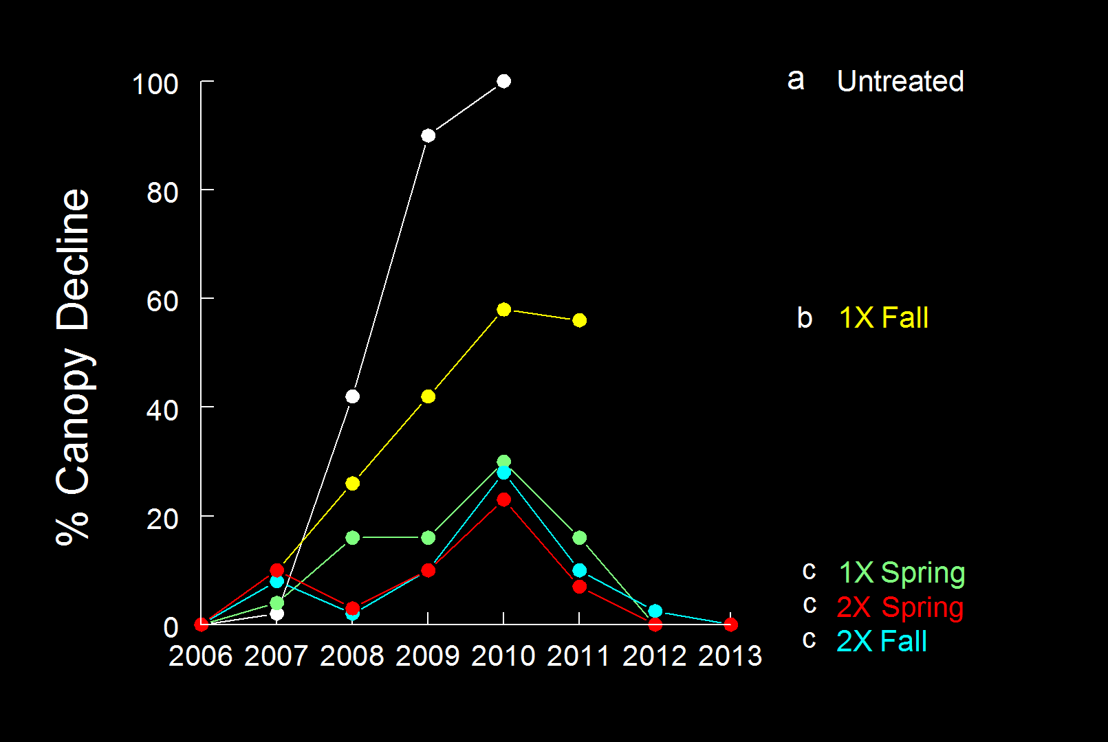
Imidacloprid Soil Drenches (16-23 inch DBH)
Dan Herms, Ohio State University

Slide 58
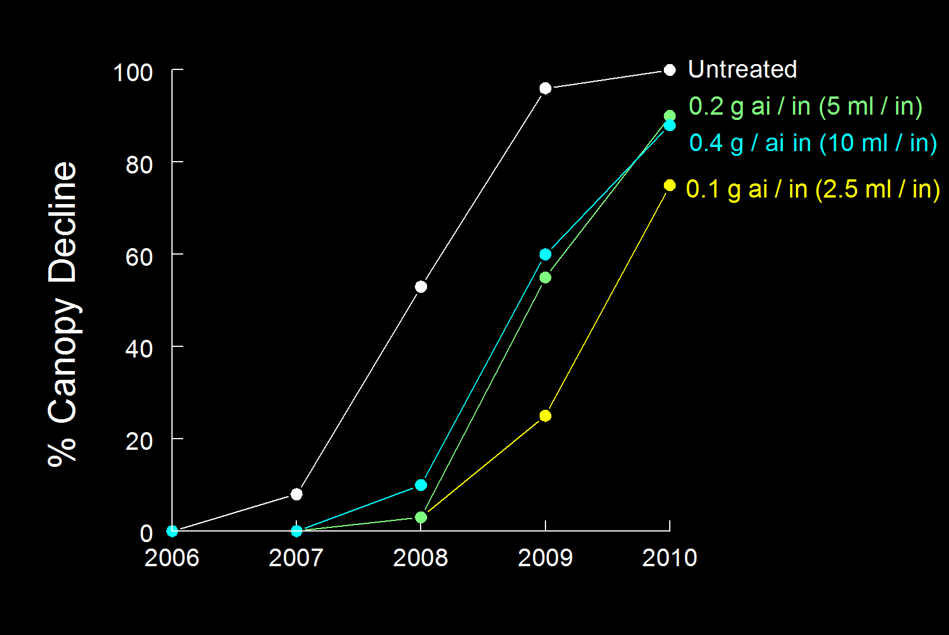
Tree-äge rate study: 2 yrs control even at low rate (20-25 inch DBH)
Dan Herms, Ohio State University

Slide 59
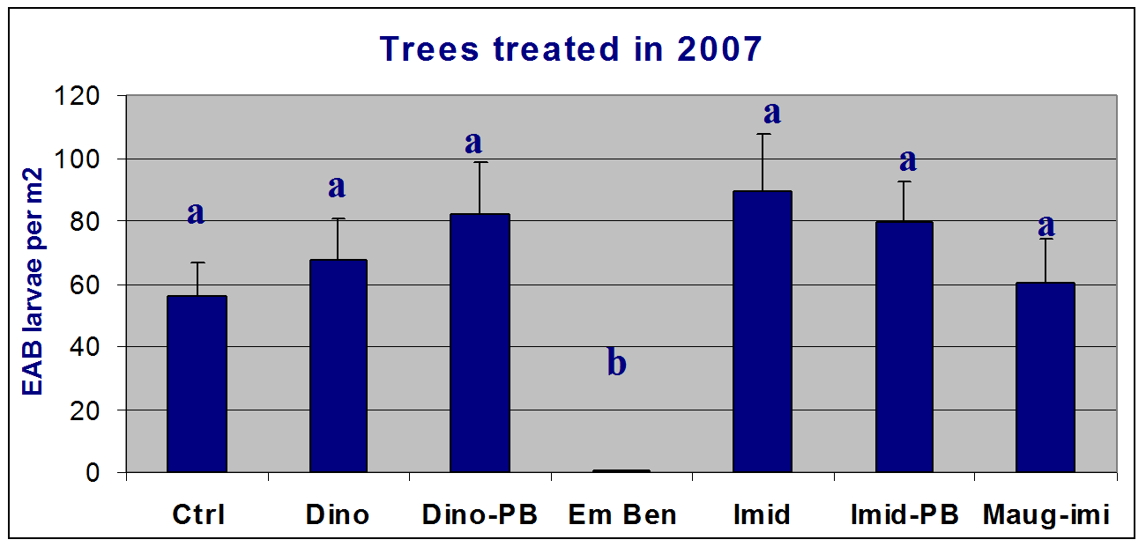
One vs Two Years of Control
Trees treated in 2007 & 2008
120
a
100
80
ab
EAB larvae per m2
abc
60
abc
bc
40
bc
c
20
0
Ctrl
Dino
Dino-PB
Em Ben
Imid
Imid-PB
Maug-imi
Deb McCullough, MSU

Slide 60
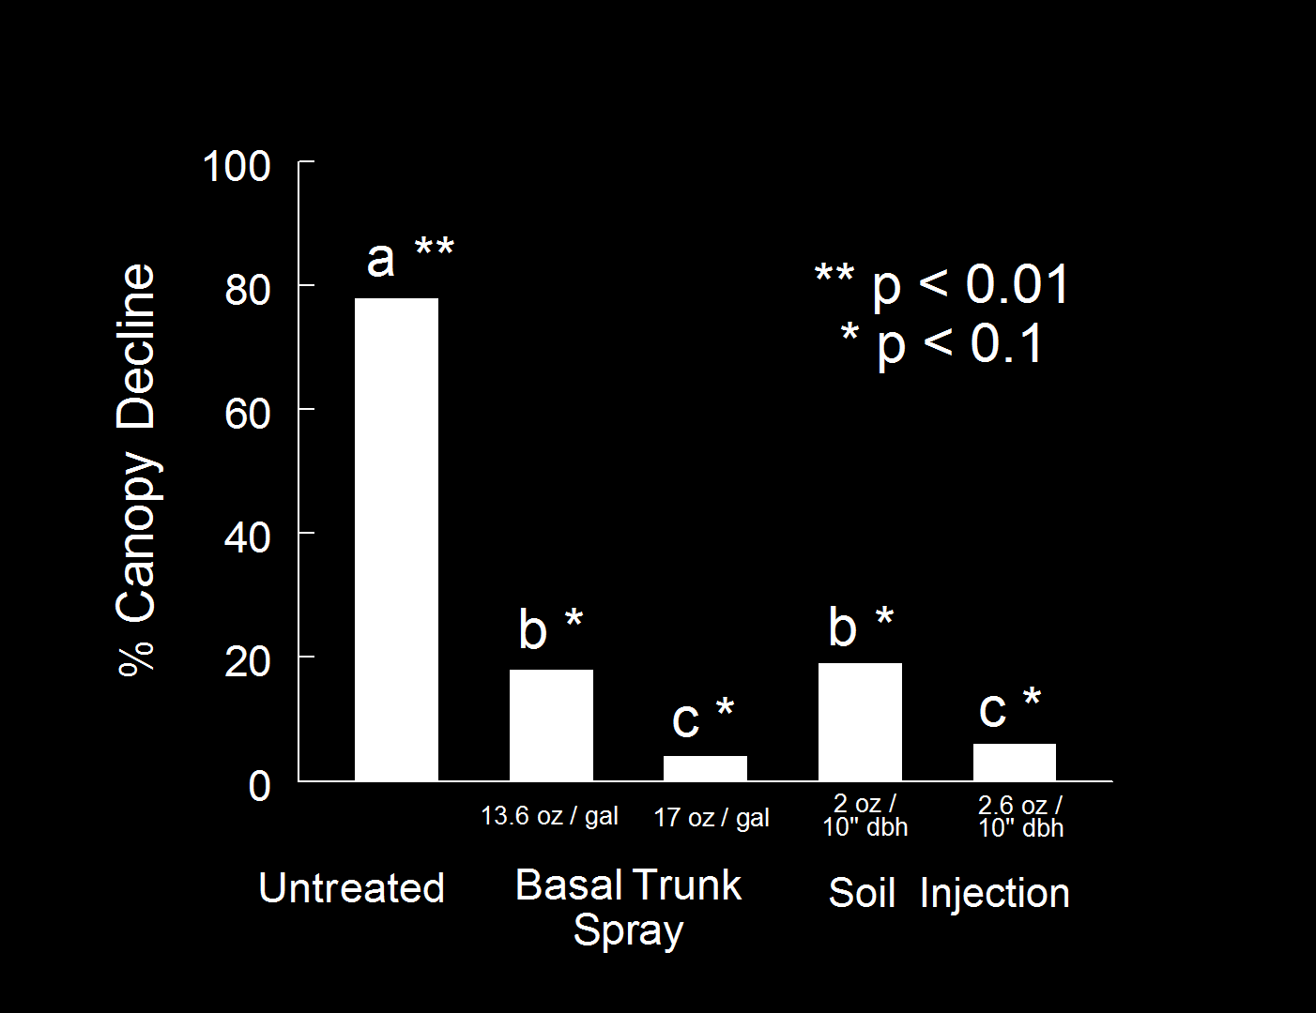
Dinotefuran (Safari) Treatments for EAB
Treated 2008-2012; evaluated 2013
Dan Herms, Ohio State University

Slide 61
Comparison of Systemic Insecticide Products for Control of EAB
Trees treated 11 June 2010 and 9 June 2011
Dan Herms, Ohio State University

Slide 62
Effect of Emamectin Benzoate for Control of EAB
on big trees (32-47 inch DBH)
% Canopy Decline
Treatment
2010
2011
2012
2013
0.2 g ai / inch DBH (5 ml / in) 10 13 6 1
0.4 g ai / inch DBH (10 ml / in) 11 14 7 1
Dan Herms, Ohio State University

Slide 63
Pesticide BMP’s
Spring applications are always best, mid May through June.
Fall applications work, but must be 2x for imidacloprid
Must start early in the infestation cycle to retain maximum tree health – Early detection is key
Plan for treatments at least 12 years in the future
How many times can you repeatedly inject a tree?
Large trees (>15 in. dbh) and those with crown symptoms can be saved.
Pressurized injectors don’t seem to be working

Slide 64
BMP’s for trees with crown symptoms
Generally not worth trying to save a tree with more than 30% canopy decline.
Use Safari as soon as possible for rapid destruction of feeding larvae.
Will not be effective with late instar larvae.
Label states no application after early August.
Simultaneously treat with Tree-äge.
Efficacy with large, forest grown trees is uncertain.

Slide 65
Don’t treat trees with greater than 30% decline
David Smitley,
Michigan State University

Slide 66
BMP’s for large trees
Imidacloprid soil drenches are most effective on larger trees when applied at the 2x rate (2.8g ai/in. DBH).
The label for Merit, Xytect, and other generics was recently changed in NY so that a 2x treatment rate can be used on trees greater than 15 inches DBH.
TREE-äge provides two years of control in very large trees (40 to 50 in. DBH) even at the lowest rate (0.1g ai/in. DBH)
Efficacy with large, forest grown trees is uncertain.
Much smaller crown than urban trees.

Slide 67
EAB Death Curve
Dan Herms, Ohio State University, 2012.

Slide 68
Pesticide Use Strategies
Communities are using insecticide treatment to spread out tree removals according to their schedule, not the bugs.
Basically flattening out the Death Curve
Some communities in the Midwest have chosen to treat all their street trees retaining valuable canopy.
Naperville, IL will treat all their 15,000 remaining ash trees
Rochester, NY actively treating all municipal trees

Slide 69
Summer/Fall
Larval growth
Winter
Pre-pupae
Early spring
Pupation
May/June
Adult Emergence
Ovary maturation
June/July
Oviposition
1-Year
Life Cycle

Slide 70
Urban SLAM – SLow Ash Mortality
Deborah G. McCullough & Rodrigo J. Mercader (2012): Evaluation of potential strategies to SLow Ash Mortality (SLAM) caused by emerald ash borer (Agrilus planipennis): SLAM in an urban forest, International Journal of Pest Management, 58:1, 9-23

Slide 71
20% EAB Solution
(McCullough and Mercator 2011)
Year 0

Slide 72
20% EAB Solution
(McCullough and Mercator 2012)
Year 1

Slide 73
20% EAB Solution
(McCullough and Mercator 2012)
Year 2

Slide 74
20% EAB Solution
(McCullough and Mercator 2012)
Year 3

Slide 75
20% EAB Solution
(McCullough and Mercator 2012)
Year 4

Slide 76
20% EAB Solution
(McCullough and Mercator 2012)
Year 5

Slide 77
The 33% Solution!

Slide 78
33% EAB Solution
(McCullough and Mercator 2011)
Year 0

Slide 79
33% EAB Solution
(McCullough and Mercator 2011)
Year 1

Slide 80
33% EAB Solution
(McCullough and Mercator 2011)
Year 2

Slide 81
33% EAB Solution
(McCullough and Mercator 2011)
Year 3

Slide 82
eabindiana.info
Created by Cliff Sadof, Purdue University

Slide 84
eabindiana.info

Slide 85
Urban SLAM Cost Comparison
Cliff Sadof, Purdue University (2013)

Slide 86
Benefits of Urban Trees
Two models used: CTLA & iTree
Landscaping – up to 40% of property value
Energy savings
Water interception and use
Business activity
Human health

Slide 87
Benefits of Urban Trees
Results suggest that loss of trees to the emerald ash borer increased mortality related to cardiovascular and lower-respiratory-tract illness. This finding adds to the growing evidence that the natural environment provides major public health benefits.

Slide 88
Size of Remaining Ash Forest
Cliff Sadof, Purdue University (2013)

Slide 89
nyis.info
Mark Whitmore
mcw42@cornell.edu

